Slide 1
Fundamentals of Object Oriented Programming
Dr. Ayesha Hakim

Slide 2
MODULE 1

Slide 3
Contents
Introduction to procedural/structured, modular and object-oriented programming techniques
Limitations of procedural programming
Need of object-oriented programming
Object Oriented Programming features
Objects
Classes & Class as ADT
Data members
Methods
Message passing
Data encapsulation
Data abstraction
Information hiding
Inheritance(Code Reuse)
Polymorphism(Function overloading and operator overloading)

Slide 4
Fundamentals of OO Programming
C++ Program Structure
C++ Identifiers
C++ Keywords
Comments
Primitive Built- in Types
Variable declarations
Local scope v/s Global Scope
Literals
Const keyword

Slide 5
Fundamentals of OO Programming (Continued)
Defining Function & Function Prototyping
Function Declaration
Function Calling
Inline Function
Pointers
This pointer
C++ References
Standard INPUT & OUTPUT Streams
Class Constructor & Destructor
Static Keyword
Static data members
Static member function
Dynamic memory Allocation & De-allocation
New & Delete operator
I/O manipulation

Slide 6
A Survey of Programming Techniques
Unstructured programming
Procedural programming
Modular programming
Object-oriented programming

Slide 7
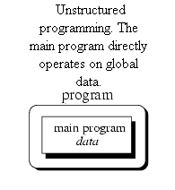
Unstructured programming
Only one Program i.e. main Program
All the sequences of commands or statements in one program called main Program
E.g. Fortran, assembly language, old Basic

Slide 8
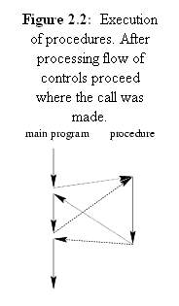
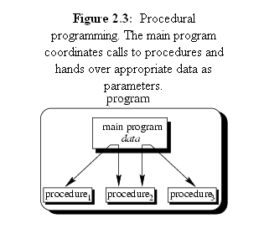
Structured Programming
Also called as Procedural Programming
For each task procedure is created
The procedures are called from main

Slide 9
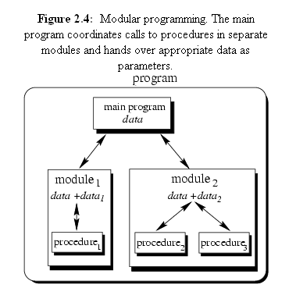
Modular programming
Procedures with some common functionality are grouped together into separate modules
Program is categorized into several smaller modules
Each module can have its own data

Slide 10
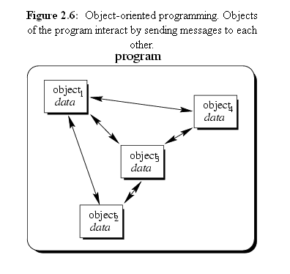
Object-oriented programming
Works on objects which is considered smallest unit of the object oriented languages
Focuses more on data rather than Procedures

Slide 11
Example
Unstructured Programming:
#include #include void main() { int a,b,c; clrscr(); cout << "Enter the first number"; cin >> a; cout << "Enter the second number"; cin >> b; c=a+b; cout << "The sum is:" << c; getch(); }

Slide 12
Example
Procedural Programming:
#include #include
int add(int,int); void main() { int a,b,c; clrscr(); cout << "Enter the first number"; cin >> a; cout << "Enter the second number"; cin >> b; c=add(a,b); cout<<"The sum is:" << c; getch(); } int add(int x,int y) { int z=x+y; return z; }

Slide 13
Example
Object Oriented programming
#include #include class Addition { int a,b,c; public: void read() { cin >> a; cin >> b; } void add() { c=a+b; } void display() { cout << "The sum is:" << c; } };
void main() { Addition obj; //object creation cout << "Enter the numbers"; obj.read(); obj.add(); obj.display(); getch(); }

Slide 14
Limitations of procedural programming
Poor real world model.
No importance to data.
No privacy.
No true reuse.
Functions and data should be treated equally.

Slide 15
Procedural v/s object oriented programming

Slide 16
Feature | Procedure oriented Programming | Object oriented Programming
Divided Into | In POP Program is divided into small parts called functions | In OOP, program is divided into parts called objects.
Importance | In POP, Importance is not given to data but to functions as well as sequence of actions to be done. | In OOP, Importance is given to the data rather than procedures or functions because it works as a real world.
Approach | POP follows Top Down approach. | OOP follows Bottom Up approach
Access Specifiers | POP does not have any access specifier | OOP has access specifiers named Public, Private, Protected, etc.
Data Moving | In POP, Data can move freely from function to function in the system. | In OOP, objects can move and communicate with each other through member functions.
Expansion | To add new data and function in POP is not so easy. | OOP provides an easy way to add new data and function
Data Access | In POP, Most function uses Global data for sharing that can be accessed freely from function to function in the system. | In OOP, data can not move easily from function to function, it can be kept public or private so we can control the access of data.
Data Hiding | POP does not have any proper way for hiding data so it is less secure. | OOP provides Data Hiding so provides more security.
Overloading | In POP, Overloading is not possible. | In OOP, overloading is possible in the form of Function Overloading and Operator Overloading.
Examples | Example of POP are : C, VB, FORTRAN, Pascal. | Example of OOP are : C++, JAVA, VB.NET, C#.NET.

Slide 17
Object oriented features

Slide 18
introduction
C++ is a statically typed, compiled, general-purpose, case-sensitive, free-form programming language that supports procedural, object-oriented programming.
C++ is regarded as a middle-level language, as it comprises a combination of both high-level and low-level language features
Developed by Bjarne Stroustrup starting in 1979 at Bell Labs in Murray Hill, New Jersey

Slide 19
C++ Class Definition
It is template, format or blueprint
Also can be said as user defined data Type
A class definition starts with the keyword class followed by the class name; and the class body, enclosed by a pair of curly braces.
Class definition must be followed by a semicolon
Class contains data members and member function
class Box{
public:
double length; // Length of a box double breadth; // Breadth of a box
double height; // Height of a box
};

Slide 20
C++ Objects
A class provides the blueprints for objects
An object is created from a class
Object is variable of class type
Objects are declared the same way the variables are declared
Box Box1; // Declare Box1 of type Box
Box Box2; // Declare Box2 of type Box
Both of the objects Box1 and Box2 will have their own copy of data members.

Slide 21
Accessing the Data Members
The public data members of objects of a class can be accessed using the direct member access operator (.)
#include <iostream>
using namespace std;
class Box{
public:
double length; // Length of a box double breadth; // Breadth of a box double height; // Height of a box
};
// box 2 specification
Box2.height = 10.0;
Box2.length = 12.0;
Box2.breadth = 13.0; // volume of //box 1
volume = Box1.height * Box1.length * Box1.breadth;
cout << "Volume of Box1 : " << volume <<endl; // volume of box 2
volume = Box2.height * Box2.length * Box2.breadth; cout << "Volume of Box2 : " << volume <<endl; return 0;}
int main( ){
Box Box1; // Declare Box1 of type Box Box Box2; // Declare Box2 of type Box double volume = 0.0; // Store the volume of a box here
// box 1 specification Box1.height = 5.0;
Box1.length = 6.0;
Box1.breadth = 7.0;

Slide 22
Members of class
A member function of a class is a function that has its definition or its prototype within the class
Members are accessed using dot operator(.)
class Box
{
public:
double length; // Length of a box
double breadth; // Breadth of a box data member double height; // Height of a box
double getVolume(void); // Returns box volume
// member function
};

Slide 23
Members of class(continued…)
Member functions can be defined within the class definition or separately using scope resolution operator, ::
class Box{
public:
double length; // Length of a box
double breadth; // Breadth of a box
double height; // Height of a box
double getVolume(void){
return length * breadth * height;
}
};// class end

Slide 24
Members of class(continued…)
If you like you can define same function outside the class using scope resolution operator, :: as follows:
double Box::getVolume(void){
return length * breadth * height;
}

Slide 25
Data encapsulation
The wrapping up of data and function into a single unit (called class) is known as encapsulation. Data and encapsulation is the most striking feature of a class.
OOP encapsulates data (attributes) and functions (behavior) into packages called objects
E.g. class encapsulates data members and member functions

Slide 26
Data abstraction
Abstraction refers to the act of representing essential features without including the background details or explanation
Classes use the concept of abstraction and are defined as a list of abstract attributes such as size, wait, and cost, and function operate on these attributes.
E.g TV
a television separates its internal implementation from its external interface and we can play with its interfaces like the power button, channel changer, and volume control without having any knowledge of its internals.

Slide 27
Information hiding
Data hiding is one of the important features of Object Oriented Programming which allows preventing the functions of a program to access directly the internal representation of a class type
The access restriction to the class members is specified by the labeled public, private, and protected sections within the class body
private, and protected are called access specifiers/modifiers.
A class can have multiple public, protected, or private labeled sections
The default access for members and classes is private

Slide 28
Information hiding(continued)
class Base {
public: // public members go here
protected: // protected members go here
private: // private members go here
};

Slide 29
Information hiding(continued)
A public member is accessible from anywhere outside the class but within a program
A private member variable or function cannot be accessed, or even viewed from outside the class. Only the class and friend functions can access private members.
By default all the members of a class would be private
A protected member variable or function is very similar to a private member but it provides one additional benefit that they can be accessed in child classes which are called derived classes

Slide 30
inheritance
Inheritance is the process by which objects of one class acquired the properties of objects of another classes.
In OOP, the concept of inheritance provides the idea of reusability
Can add additional features to an existing class without modifying it

Slide 31
inheritance
•inheritance: Forming new classes based on existing ones.
§a way to share/reuse code between two or more classes
§
§superclass: Parent class being extended.
§subclass: Child class that inherits behavior from superclass.
•gets a copy of every field and method from superclass
•
§is-a relationship: Each object of the subclass also "is a(n)" object of the superclass and can be treated as one.

Slide 32
inheritance syntax
public class name extends superclass {
§Example:
public class Lawyer extends Employee {
...
}
•By extending Employee, each Lawyer object now:
§receives a copy of each method from Employee automatically
§can be treated as an Employee by client code
§
•Lawyer can also replace ("override") behavior from Employee.

Slide 33
the ‘super’ keyword
•A subclass can call its parent's method/constructor:
super.method(parameters) // method super(parameters); // constructor
public class Lawyer extends Employee {
public Lawyer(String name) {
super(name);
}
// give Lawyers a $5K raise (better)
public double getSalary() {
double baseSalary = super.getSalary();
return baseSalary + 5000.00;
}
}

Slide 34
polymorphism
Polymorphism is another important OOP concept. Polymorphism, a Greek term, means the ability to take more than one form.
Ability for the same code to be used with different types of objects and behave differently with each.
The process of making an operator to exhibit different behaviors in different instances is known as operator overloading.
Using a single function name to perform different type of task is known as function overloading.

Slide 35
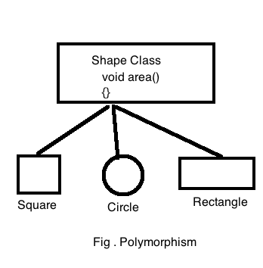
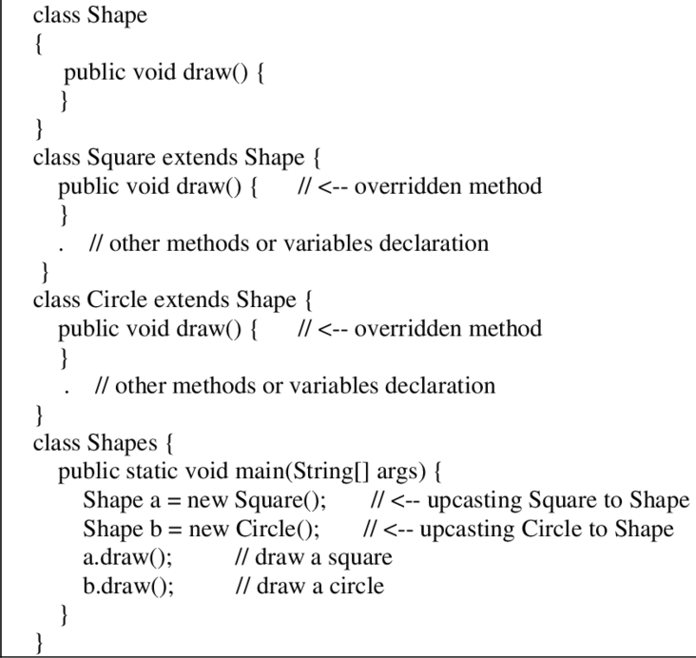
In Java, when we only declare a variable of a class type, only a reference is created (memory is not allocated for the object). To allocate memory to an object, we must use new().
Static binding works during compile time and performs better.
Static binding can be applied using function overloading or operator overloading.

Slide 36
POLYMORPHIC PARAMETERS
•You can pass any subtype of a parameter's type.
public static void main(String[] args) {
Lawyer lisa = new Lawyer();
Secretary steve = new Secretary();
printInfo(lisa);
printInfo(steve);
}
public static void printInfo(Employee e) {
System.out.println("pay : " + e.getSalary());
System.out.println("vdays: " + e.getVacationDays());
System.out.println("vform: " + e.getVacationForm());
System.out.println();
}
OUTPUT:
pay : 50000.0 pay : 50000.0
vdays: 15 vdays: 10
vform: pink vform: yellow

Slide 37
Runtime polymorphism in java
Runtime polymorphism, also known as the Dynamic Method Dispatch, is a process that resolves a call to an overridden method at runtime. The process involves the use of the reference variable of a superclass to call for an overridden method.
The method to be called will be determined based on the object being referred to by the reference variable.

Slide 38
Benefits of Runtime Polymorphism in Java
The primary advantage of runtime polymorphism is enabling the class to offer its specification to another inherited method. This implementation transfer from one method to another can be done without altering or changing the codes of the parent class object. Also, the call to an overridden method can be resolved dynamically during runtime.
What is Method Overriding?
Runtime polymorphism in Java can be carried out only by method overriding. Method overriding occurs when objects possess the same name, arguments, and type as their parent class but have different functionality. When a child class has such a method in it, it is called an overridden method.

Slide 39
What is Upcasting?
When an overridden method of child class is called through its parent type reference in Java, it is called upcasting. In this process, the object type represents the method or functionality that will be invoked. This decision is made during the runtime, and hence, the name run time polymorphism is given to the process.
Run time polymorphism is also known as Dynamic Method Dispatch as the method functionality is decided dynamically at run time based on the object.
It is also called “Late Binding” as the process of binding the method with the object occurs late after compilation.

Slide 40
Rules to be Followed When Executing Run Time Polymorphism
Below is a set of essential rules in run time polymorphism:
Both the child and the parent class should have the same method names.
Child and the parent class methods should have the same parameter.
It is not possible to override the private methods of a parent class.
It is not possible to override static methods.

Slide 41
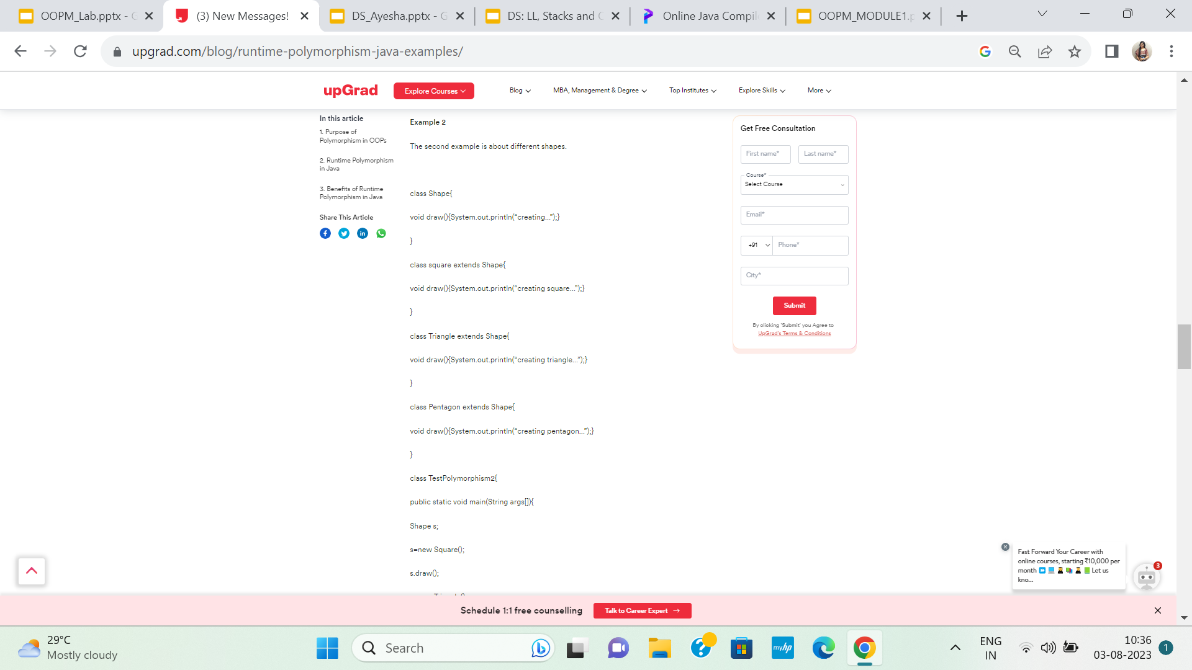
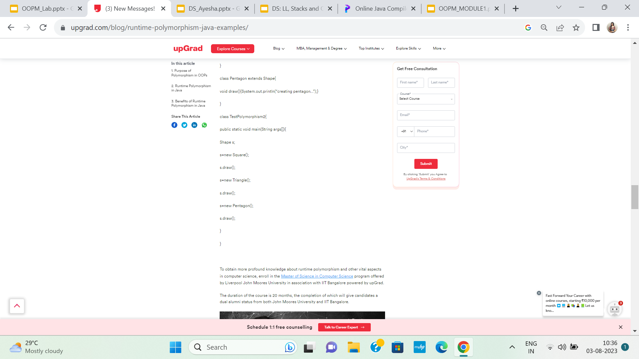
EXAMPLE

Slide 42
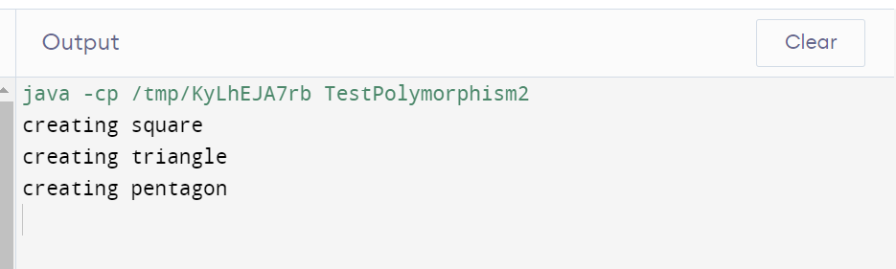
Dynamic binding works during run time & is more flexible.

Slide 43
Reuse Concept
Code reusability, an important feature of Object-Oriented Programming (OOP), is enabled through inheritance, polymorphism, and information hiding.
Reusability in OOP this allows developers to save time and effort by not having to write the same code over again. Reusability also helps to reduce the amount of code that needs to be written and maintained, making programs more efficient and easier to maintain.

Slide 44
Coupling & Cohesion
Cohesion: Cohesion is the indication of the relationship within the module. It is the concept of intra-module. Cohesion has many types but usually, high cohesion is good for software.
Coupling: Coupling is also the indication of the relationships between modules. It is the concept of the Inter-module. The coupling has also many types but usually, the low coupling is good for software.

Slide 45
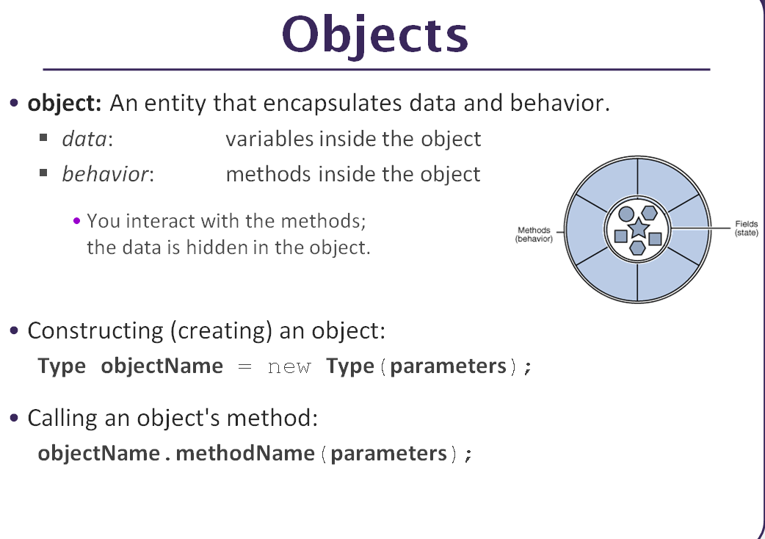

Slide 46
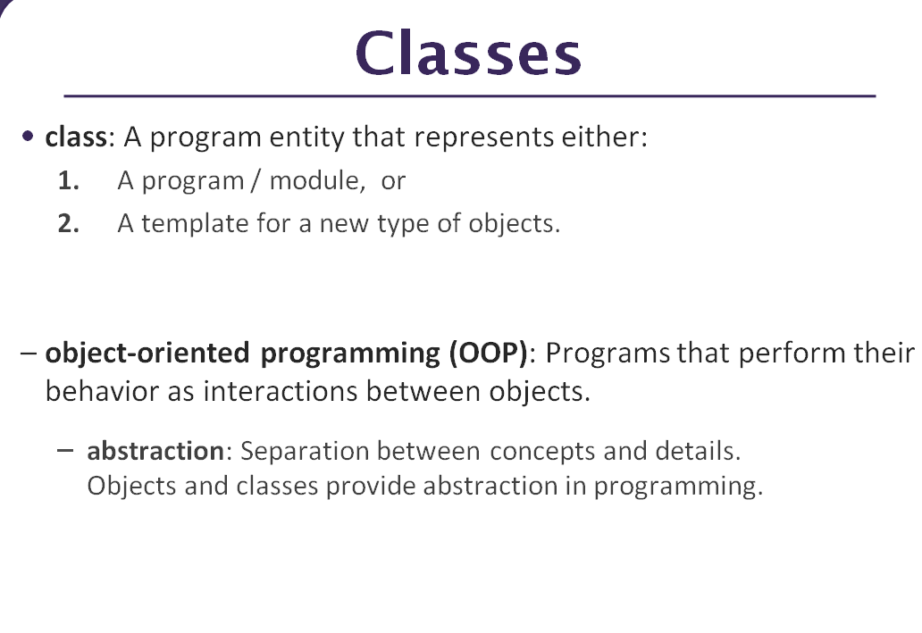

Slide 47
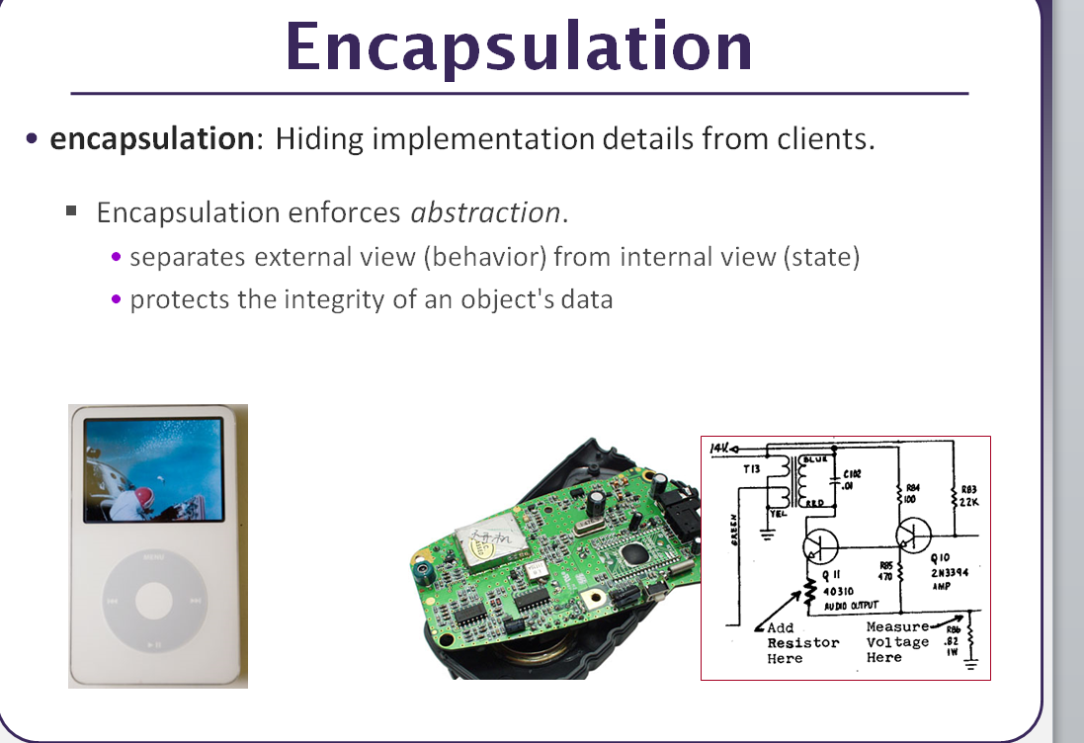

Slide 48
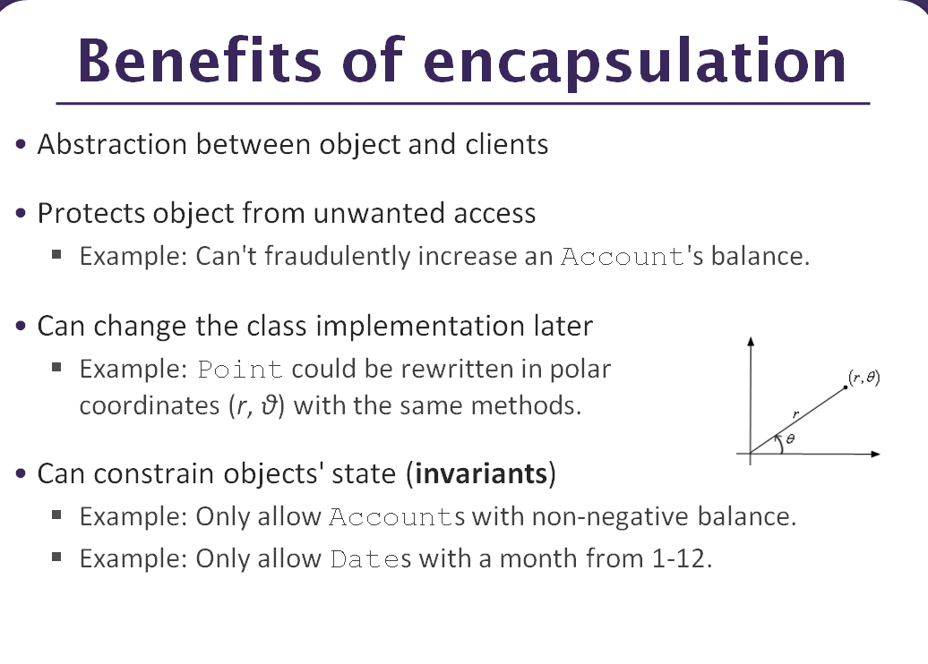

Slide 49
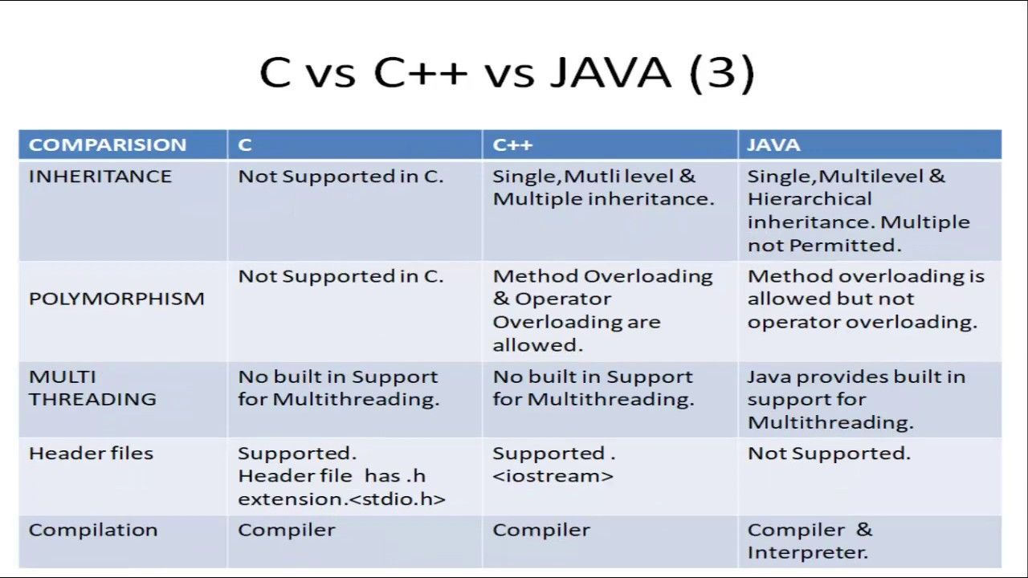
object oriented features of C++ and Java

Slide 50
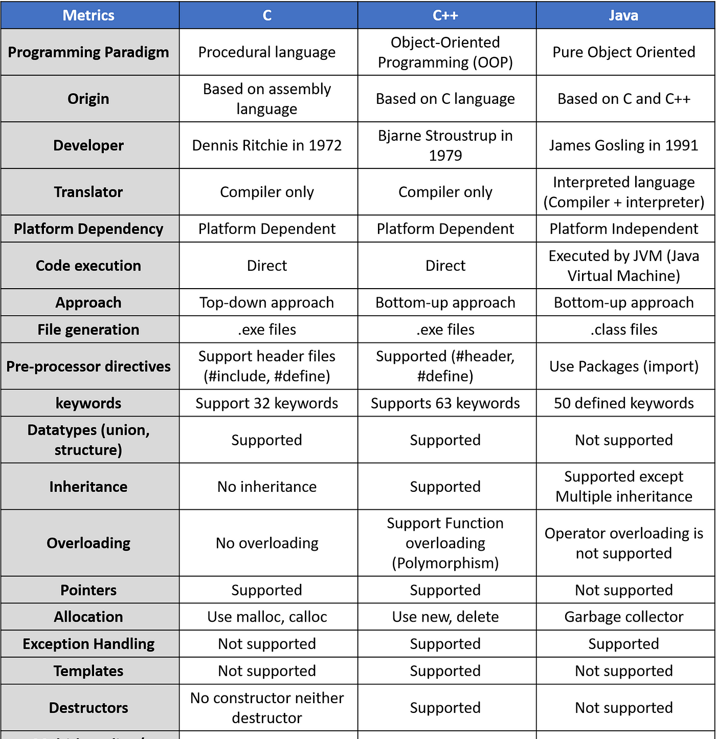

Slide 51
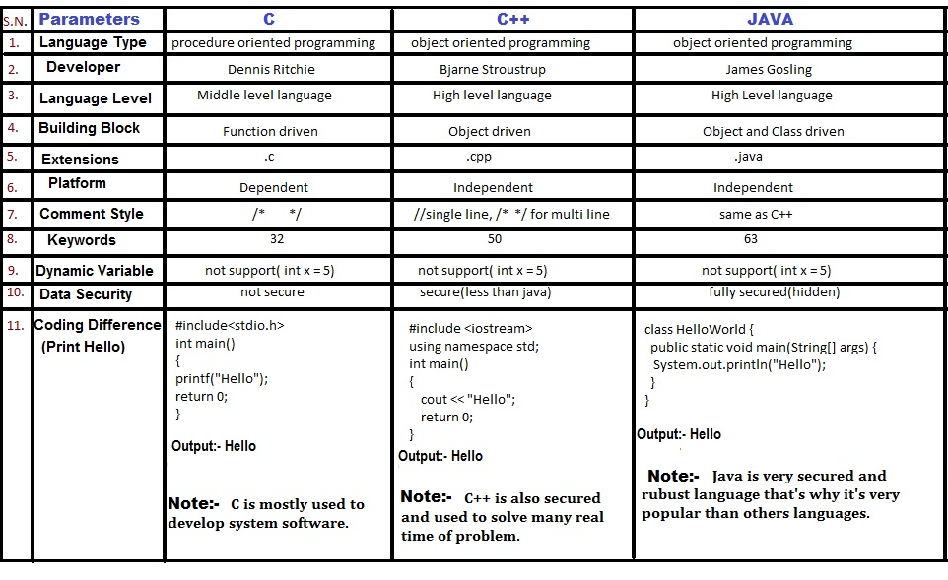

Slide 52
EXCEPTION HANDLING
Exception is an event that occurs during the execution of a program and that disrupts the normal flow of instructions.
Java exceptions are specialized events that indicate something bad has happened in the application, and the application either needs to recover or exit.

Slide 53
Why handle Java exceptions?
Java exception handling is important because it helps maintain the normal, desired flow of the program even when unexpected events occur.
If Java exceptions are not handled, programs may crash or requests may fail. This can be very frustrating for customers and if it happens repeatedly, you could lose those customers.
The worst situation is if your application crashes while the user is doing any important work, especially if their data is lost.
To make the user interface robust, it is important to handle Java exceptions to prevent the application from unexpectedly crashing and losing data. There can be many causes for a sudden crash of the system, such as incorrect or unexpected data input. For example, if we try to add two users with duplicate IDs to the database, we should throw an exception since the action would affect database integrity.

Slide 54
Tracking Exceptions in Java
Exceptions will happen in your application, no matter how well you write your program. You cannot predict the runtime environment entirely, especially that of your customer’s.
The standard practice is to record all events in the application log file. The log file acts as a time machine helping the developer (or analyst) go back in time to view all the phases the application went through and what led to the Java exception.
For small-scale applications, going through a log file is easy. However, enterprise applications can serve thousands or even millions of requests per second. This makes manual analysis too cumbersome because errors and their causes can be lost in the noise.
This is where error monitoring software can help by grouping duplicates and providing summarized views of the top and most recent Java errors. They can also capture and organize contextual data in a way that’s easier and faster than looking at logs.

Slide 55
How to handle Java exceptions?
This is accomplished using the keywords: try, catch, throw, throws, and finally.
You try to execute the statements contained within a block of code. (A block of code is a group of one or more statements surrounded by braces.)
If you detect an exceptional condition within that block, you throw an exception object of a specific type.
You catch and process the exception object using code that you have designed.
You optionally execute a block of code, designated by finally, which needs to be executed whether or not an exception occurs. (Code in the finally block is normally used to perform some type of cleanup.)

Slide 56
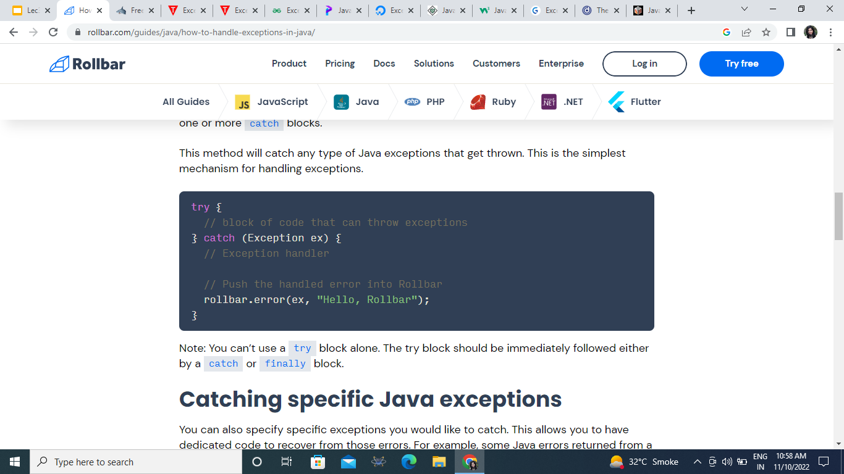
How to handle exceptions in Java
The try-catch is the simplest method of handling exceptions. Put the code you want to run in the try block, and any Java exceptions that the code throws are caught by one or more catch blocks.
This method will catch any type of Java exceptions that get thrown.

Slide 57
Java - General
Java is:
platform independent programming language
similar to C++ in syntax
Java has some interesting features:
automatic type checking,
automatic garbage collection,
simplifies pointers; no directly accessible pointer to memory,
simplified network access,
multi-threading!

Slide 58
How it works…!
Compile-time Environment
Compile-time Environment
Class Loader
Bytecode
Verifier
Java Class
Libraries
Java
Source
(.java)
Java
Interpreter
Just in Time
Compiler
Java
Bytecodes
move locally
or through
network
Java
Virtual
machine
Java
Compiler
Runtime System
Java
Bytecode
(.class )
Operating System
Hardware

Slide 59
How it works…!
Java is independent only for one reason:
Only depends on the Java Virtual Machine (JVM),
code is compiled to bytecode, which is interpreted by the resident JVM,
JIT (just in time) compilers attempt to increase speed.

Slide 60
Java - Security
Pointer denial - reduces chances of virulent programs corrupting host,
Applets even more restricted -
May not
run local executables,
Read or write to local file system,
Communicate with any server other than the originating server.

Slide 61
Object-Oriented
Java supports:
Polymorphism
Inheritance
Encapsulation
Java programs contain nothing but definitions and instantiations of classes
Everything is encapsulated in a class!

Slide 62
Java Advantages
Portable - Write Once, Run Anywhere
Security has been well thought through
Robust memory management
Designed for network programming
Multi-threaded (multiple simultaneous tasks)
Dynamic & extensible (loads of libraries)
Classes stored in separate files
Loaded only when needed

Slide 63
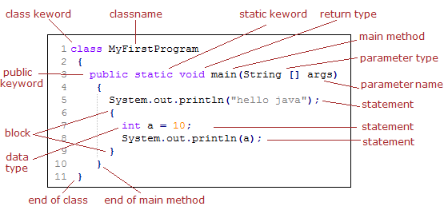
Basic Java Syntax

Slide 64
Primitive Types and Variables
boolean, char, byte, short, int, long, float, double etc.
These basic (or primitive) types are the only types that are not objects (due to performance issues).
This means that you don’t use the new operator to create a primitive variable.
Declaring primitive variables:
float initVal;
int retVal, index = 2;
double gamma = 1.2, brightness
boolean valueOk = false;

Slide 65
Initialisation
If no value is assigned prior to use, then the compiler will give an error
Java sets primitive variables to zero or false in the case of a boolean variable
All object references are initially set to null
An array of anything is an object
Set to null on declaration
Elements to zero false or null on creation

Slide 66
Declarations
int index = 1.2; // compiler error
boolean retOk = 1; // compiler error
double fiveFourths = 5 / 4; // no error!
float ratio = 5.8f; // correct
double fiveFourths = 5.0 / 4.0; // correct
1.2f is a float value accurate to 7 decimal places.
1.2 is a double value accurate to 15 decimal places.

Slide 67
Assignment
All Java assignments are right associative
int a = 1, b = 2, c = 5
a = b = c
System.out.print(
“a= “ + a + “b= “ + b + “c= “ + c)
What is the value of a, b & c
Done right to left: a = (b = c);

Slide 68
Basic Mathematical Operators
* / % + - are the mathematical operators
* / % have a higher precedence than + or -
double myVal = a + b % d – c * d / b;
Is the same as:
double myVal = (a + (b % d)) –
((c * d) / b);

Slide 69
Statements & Blocks
A simple statement is a command terminated by a semi-colon:
name = “Fred”;
A block is a compound statement enclosed in curly brackets:
{
name1 = “Fred”; name2 = “Bill”;
}
Blocks may contain other blocks

Slide 70
Flow of Control
Java executes one statement after the other in the order they are written
Many Java statements are flow control statements:
Alternation: if, if else, switch
Looping: for, while, do while
Escapes: break, continue, return

Slide 71
If – The Conditional Statement
The if statement evaluates an expression and if that evaluation is true then the specified action is taken
if ( x < 10 ) x = 10;
If the value of x is less than 10, make x equal to 10
It could have been written:
if ( x < 10 )
x = 10;
Or, alternatively:
if ( x < 10 ) { x = 10; }

Slide 72
Relational Operators
== Equal (careful)
!= Not equal
>= Greater than or equal
<= Less than or equal
> Greater than
< Less than

Slide 73
If… else
The if … else statement evaluates an expression and performs one action if that evaluation is true or a different action if it is false.
if (x != oldx) {
System.out.print(“x was changed”);
}
else {
System.out.print(“x is unchanged”);
}

Slide 74
Nested if … else
if ( myVal > 100 ) {
if ( remainderOn == true) {
myVal = mVal % 100;
}
else {
myVal = myVal / 100.0;
}
}
else
{
System.out.print(“myVal is in range”);
}

Slide 75
else if
Useful for choosing between alternatives:
if ( n == 1 ) {
// execute code block #1
}
else if ( j == 2 ) {
// execute code block #2
}
else {
// if all previous tests have failed, execute code block #3
}

Slide 76
A Warning…
WRONG!
if( i == j )
if ( j == k )
System.out.print(
“i equals k”);
else
System.out.print(
“i is not equal to j”);
CORRECT!
if( i == j ) {
if ( j == k )
System.out.print(
“i equals k”);
}
else
System.out.print(“i is not equal to j”); // Correct!

Slide 77
The Switch Statement
switch ( n ) {
case 1:
// execute code block #1
break;
case 2:
// execute code block #2
break;
default:
// if all previous tests fail then //execute code block #4
break;
}

Slide 78
The for loop
Loop n times
for ( i = 0; i < n; n++ ) {
// this code body will execute n times
// ifrom 0 to n-1
}
Nested for:
for ( j = 0; j < 10; j++ ) {
for ( i = 0; i < 20; i++ ){
// this code body will execute 200 times
}
}

Slide 79
while loop
while(response == 1) {
System.out.print( “ID =” + userID[n]);
n++;
response = readInt( “Enter “);
}
What is the minimum number of times the loop is executed?
What is the maximum number of times?

Slide 80
do {… } while loops
do {
System.out.print( “ID =” + userID[n] );
n++;
response = readInt( “Enter ” );
}while (response == 1);
What is the minimum number of times the loop is executed?
What is the maximum number of times?

Slide 81
Break
A break statement causes an exit from the innermost containing while, do, for or switch statement.
for ( int i = 0; i < maxID, i++ ) {
if ( userID[i] == targetID ) {
index = i;
break;
}
} // program jumps here after break

Slide 82
Continue
Can only be used with while, do or for.
The continue statement causes the innermost loop to start the next iteration immediately
for ( int i = 0; i < maxID; i++ ) {
if ( userID[i] != -1 ) continue;
System.out.print( “UserID ” + i + “ :” + userID);
}

Slide 83
INTRODUCTION TO ARRAYS
Array is a group of continuous or related data items that share a common name.
Syntax:
array_name[value];
Example:
salary[10];

Slide 84
ONE-DIMENSIONAL ARRAY
A list of items can be given one variable name using only one subscript and such a variable is called a single- subscripted or One- dimensional array.
Express as:
x[1],x[2]………x[n]
The subscript of an array can be integer constants, integer variables like i, or expressions that yield integers.

Slide 85
CREATING AN ARRAY
Like any other variables, array must be declared and created in the computer memory before they are used.
Creation of an array involves three steps:-
Declaring the array
Creating memory locations
Putting values into the memory locations

Slide 86
DECLARATION OF ARRAYS
Arrays in Java may be declared in two forms:
Form1
Form2
Example:
int number[ ];
float average[ ];
int[ ] counter;
float[ ] marks;
type arrayname[ ];
Type[ ] arrayname;

Slide 87
CREATION OF ARRAYS
Java allows to create arrays using new operator only , as shown below:
Examples:
number = new int[5];
average = new float[10];
arrayname = new type[size];

Slide 88
INITIALIZATION OF ARRAYS
In this step values are put into the array created. This process is known as initialization.
Example:
number[0]=35;
number[1]=40;
. . . . . . . . . . . . .
number[n]=19;
arrayname[subscript] = value;

Slide 89
Points to ponder:
Java creates array starting with a subscript of 0 and ends with a value less than the size specified.
Trying to access an array beyond its boundaries will generate an error message.
Array can also be initialize as the other ordinary variables when they are declared.
Array initializer is a list of values separated by commas and surrounded by curly braces.

Slide 90
ARRAY LENGTH
All arrays store the allocated size in a variable named length.
To access the length of the array a using a.length.
Each dimension of the array is indexed from zero to its maximum size minus one.
Example:
int aSize = a . Length;

Slide 91
TWO-DIMENSIONAL ARRAYS
In this, the first index selects the row and the second index selects the column within that row.
For creating two-dimensional array, same steps are to be followed as that of simple arrays.
Example:
int myArray[ ][ ];
myArray = new int [3] [4];

Slide 92
REPRESENTATION OF TWO-DIMENSIONAL ARRAY IN MEMORY
column 0 column 1 column 2
[0][0] [0][1] [0][2]
Row 0
Row 1
Row 2
310
275
365
210
190
325
405
235
240

Slide 93
Arrays
An array is a list of similar things
An array has a fixed:
name
type
length
These must be declared when the array is created.
Arrays sizes cannot be changed during the execution of the code

Slide 94
myArray =
3
6
3
1
6
3
4
1
0
1
2
3
4
5
6
7
myArray has room for 8 elements
the elements are accessed by their index
in Java, array indices start at 0

Slide 95
Declaring Arrays
int myArray[];
declares myArray to be an array of integers
myArray = new int[8];
sets up 8 integer-sized spaces in memory, labelled myArray[0] to myArray[7]
int myArray[] = new int[8];
combines the two statements in one line

Slide 96
Assigning Values
refer to the array elements by index to store values in them.
myArray[0] = 3;
myArray[1] = 6;
myArray[2] = 3; ...
can create and initialise in one step:
int myArray[] = {3, 6, 3, 1, 6, 3, 4, 1};

Slide 97
Iterating Through Arrays
for loops are useful when dealing with arrays:
for (int i = 0; i < myArray.length; i++) {
myArray[i] = getsomevalue();
}

Slide 98
Arrays of Objects
So far we have looked at an array of primitive types.
integers
could also use doubles, floats, characters…
Often want to have an array of objects
Students, Books, Loans ……
Need to follow 3 steps.

Slide 99
Declaring the Array
1. Declare the array
private Student studentList[];
this declares studentList
2 .Create the array
studentList = new Student[10];
this sets up 10 spaces in memory that can hold references to Student objects
3. Create Student objects and add them to the array:
studentList[0] = new Student("Cathy", "Computing");

Slide 100
Array of Objects
If you want to store a single object in your program, then you can do so with the help of a variable of type object. But when you are dealing with numerous objects, then it is advisable to use an array of objects.
An array of objects is created using the ‘Object’ class.
The following statement creates an Array of Objects.
Class_name [] objArray;
Alternatively, you can also declare an Array of Objects as shown below:
Class_name objArray[];

Slide 101
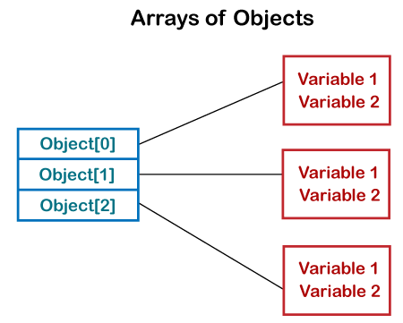

Slide 102
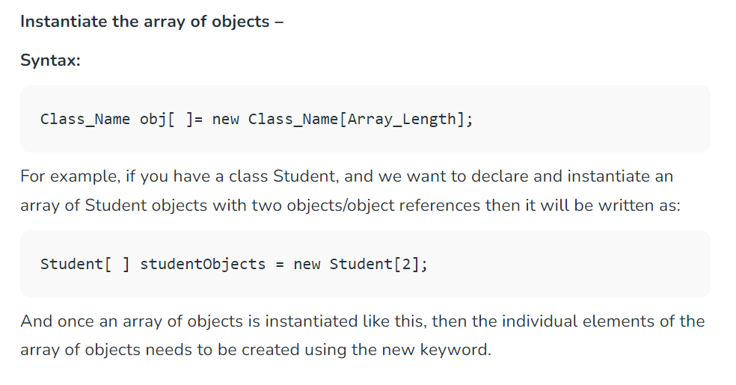

Slide 103
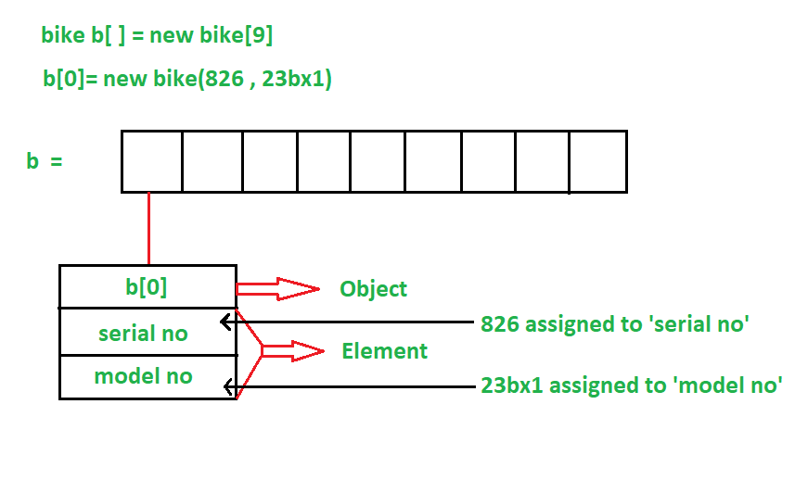

Slide 104
Initialize Array Of Objects
Once the array of objects is instantiated, you have to initialize it with values.
Each element of array i.e. an object needs to be initialized.
One way to initialize the array of objects is by using the constructors. When you create actual objects, you can assign initial values to each of the objects by passing values to the constructor.
You can also have a separate member method in a class that will assign data to the objects.
Code: https://www.geeksforgeeks.org/how-to-create-array-of-objects-in-java/
https://www.javatpoint.com/how-to-create-array-of-objects-in-java (code for ProductList example)
https://www.softwaretestinghelp.com/array-of-objects-in-java/

Slide 105
Activity: Program For An Array Of Objects In Java
WAJP to have an Employee class that has employee Id (empId) and employee name (name) as fields and ‘setData’ & ‘showData’ as methods that assign data to employee objects and display the contents of employee objects respectively.
In the main method of the program, define an array of Employee objects. Note that this will be an array of references and not actual objects. Then using the default constructor, create actual objects for the Employee class. Next, assign data to the objects using the setData method. Lastly, objects invoke the showData method to display the contents of the Employee class objects.

Slide 106
Initialize Array Of Objects - 2 ways
Code 1: The following program shows the initialization of array objects using the constructor.
Here we have used the class Employee. The class has a constructor that takes in two parameters i.e. employee name and employee Id. In the main function, after an array of employees is created, we create individual objects of the class employee. Then we pass initial values to each of the objects using the constructor.
Code 2: This program shows a member function of the Employee class that is used to assign the initial values to the Employee objects.

Slide 107
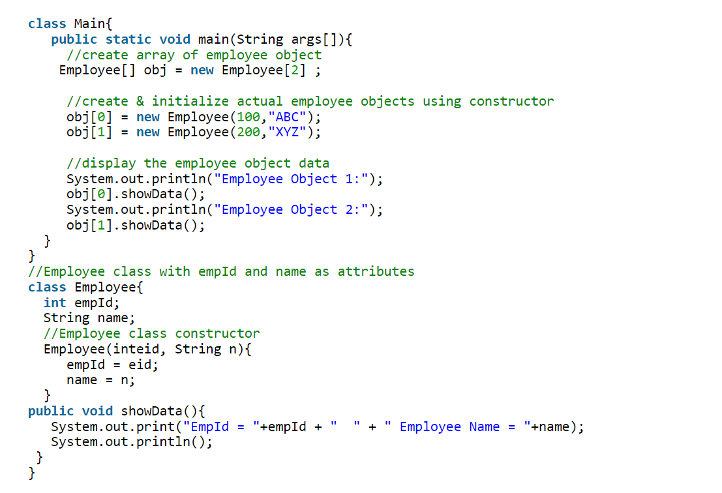
CODE 1

Slide 108
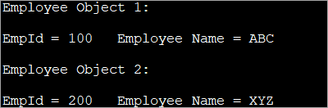
OUTPUT

Slide 109
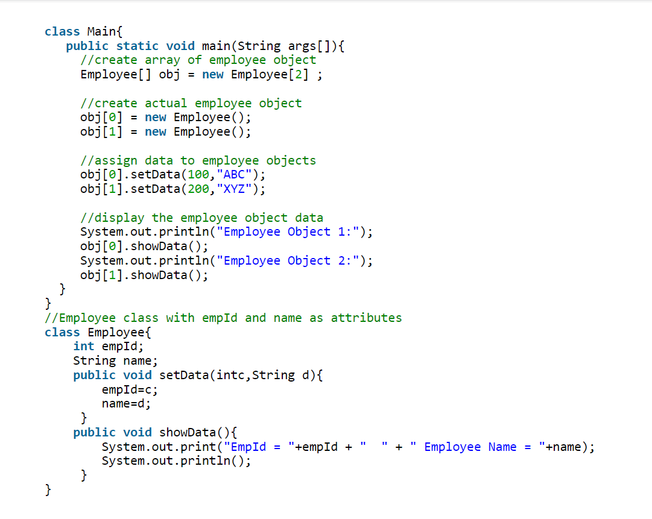
CODE 2

Slide 110
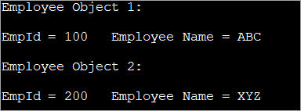
OUTPUT

Slide 111
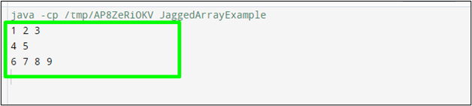
Tutorial Activity : Array of Objects, Jagged Arrays, ‘final’ keyword
WAJP to create a Rectangle class to implement the basic properties of a Rectangle. Declare an array of five Rectangle objects, to store data namely length and width (datatype double). Take values from user and print areas of all 5 rectangles.
WAJP to create the Groceries class, declare an array of Groceries objects to pass the product name, price and expiry date (dd/mm/yyyy format) as attributes for 10 products. Display the data as output. To set the data to the Groceries object use the following two approaches:
Have a separate member method in the Groceries class
Use a constructor
3. Create a Jagged array to get the following output:
4. Implement Final Variable ‘PI’ in Java program to calculate & display the area and volume of a cylinder.

Slide 112
Sample Solutions
http://www.beginwithjava.com/java/arrays-arraylist/arrays-of-objects.html
https://www.codesdope.com/course/java-array-of-objects/
https://www.scaler.com/topics/array-of-objects-in-java/
https://linuxhint.com/jagged-array-in-java-with-example/
https://www.shiksha.com/online-courses/articles/final-keyword-in-java/

Slide 113
2-D Arrays (contd.)
A two-dimensional array can have values that go not only across but also across.
Sometimes values can be conceptualized in the form of table that is in the form of rows and columns.
Suppose we want to store the marks of different subjects. We can store it in a one-dimensional array.

Slide 114
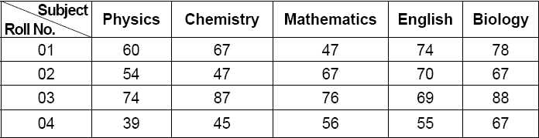
2-D Arrays (contd.)

Slide 115
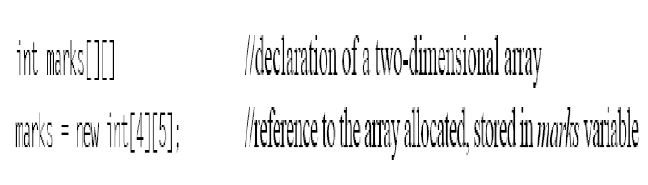
2 D Arrays (contd.)
If you want a multidimensional array, the additional index has to be specified using another set of square brackets.
Following statements create a two-dimensional array, named as marks, which would have 4 rows and 5 columns

Slide 116
2 D Arrays (contd.)
This statement just allocates a 4 × 5 array and assigns the reference to array variable marks.
The first subscript inside the square bracket signifies the number of rows in the table or matrix and the second subscript stands for the number of columns.
This 4 × 5 table can store 20 values altogether.
Its values might be stored in contiguous locations in the memory, but logically, the stored values would be treated as if they are stored in a 4 × 5 matrix.
The following table shows how the marks array is conceptually placed in the memory by the above array creation statement

Slide 117
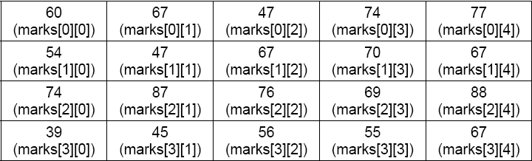
2 D Arrays (contd.)

Slide 118
2 D Arrays (contd.)
Like a one-dimensional array, two-dimensional array may be initialized with values, at the time its creation. For example,
int marks[2][4] = {2, 3, 6, 0, 9, 3, 3, 2};
This declaration shows that the first two rows of a 2 × 4 matrix have been initialized by the values shown in the list above. It can also be written as,
int marks[ ][ ] = {(2, 3, 6, 0), (9, 3, 3, 2)};

Slide 119
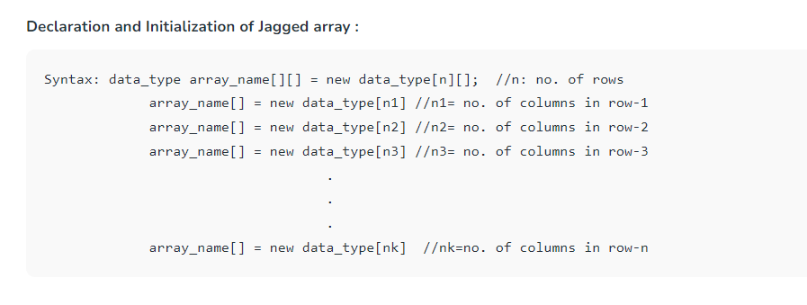
Variable length array: Jagged Arrays
Java treats multidimensional arrays as “arrays of arrays”.
A jagged array is an array of arrays such that member arrays can be of different sizes, i.e., we can create a 2-D array but with a variable number of columns in each row.
https://www.javatpoint.com/jagged-array-in-java
https://www.scaler.com/topics/java/jagged-array-in-java/

Slide 120
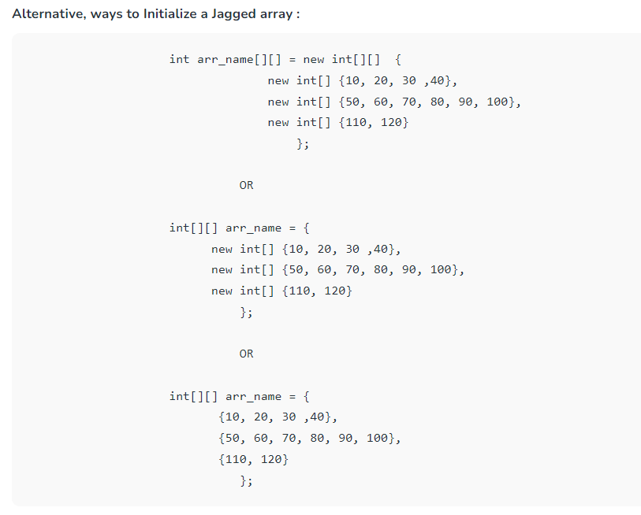

Slide 121
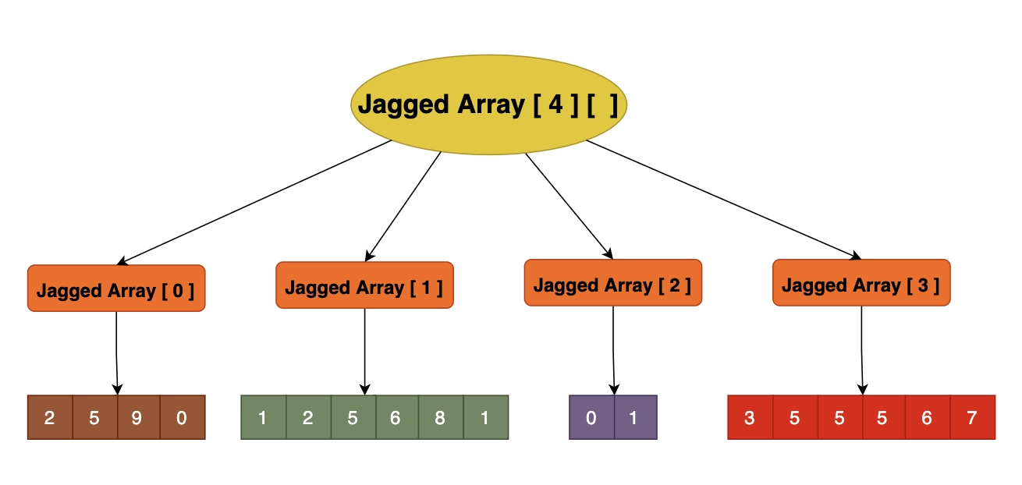
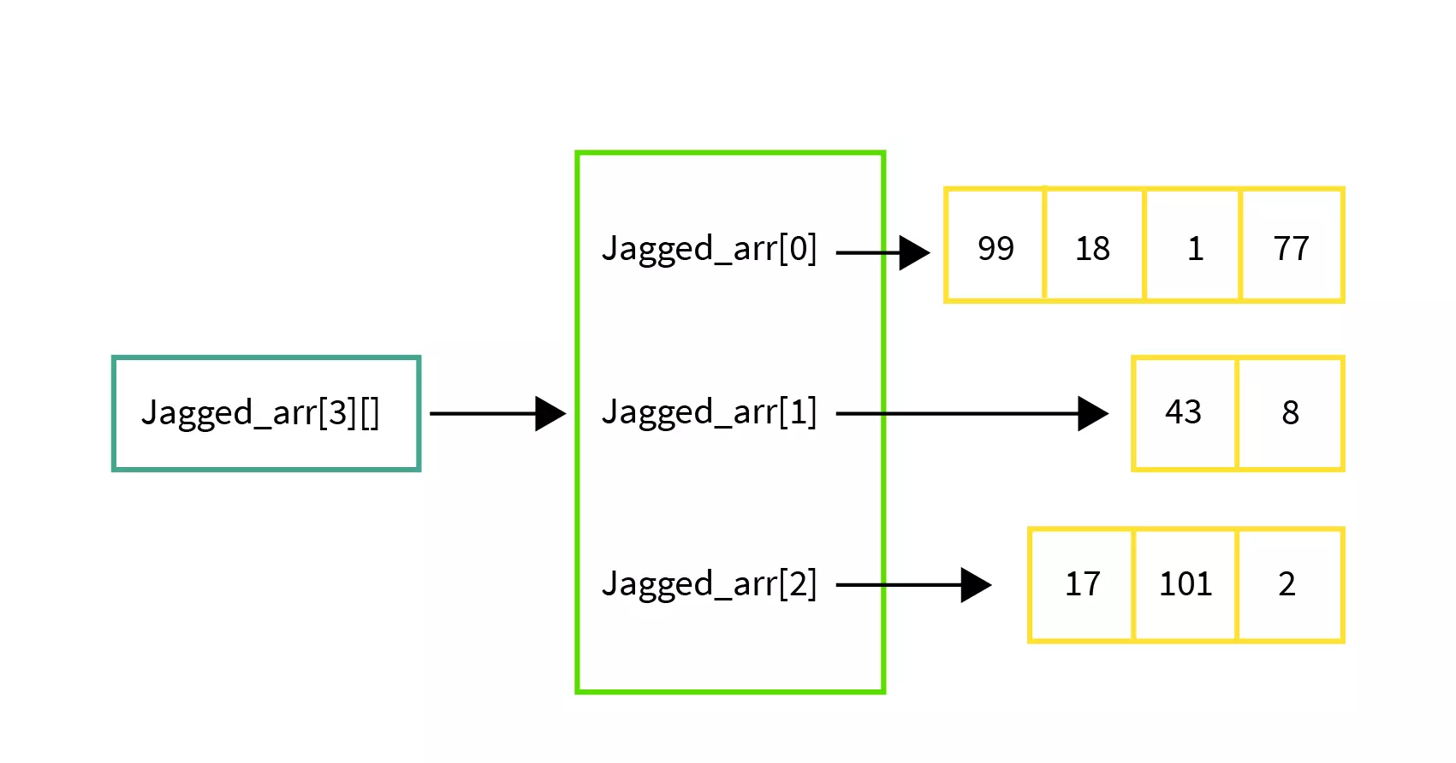

Slide 122
Jagged Arrays
Jagged arrays have the following advantages in Java:
Dynamic allocation: Jagged arrays allow you to allocate memory dynamically, meaning that you can specify the size of each sub-array at runtime, rather than at compile-time.
Space utilization: Jagged arrays can save memory when the size of each sub-array is not equal. In a rectangular array, all sub-arrays must have the same size, even if some of them have unused elements. With a jagged array, you can allocate just the amount of memory that you need for each sub-array.
Flexibility: Jagged arrays can be useful when you need to store arrays of different lengths or when the number of elements in each sub-array is not known in advance.
Improved performance: Jagged arrays can be faster than rectangular arrays for certain operations, such as accessing elements or iterating over sub-arrays, because the memory layout is more compact.
Code: https://www.geeksforgeeks.org/jagged-array-in-java/

Slide 123
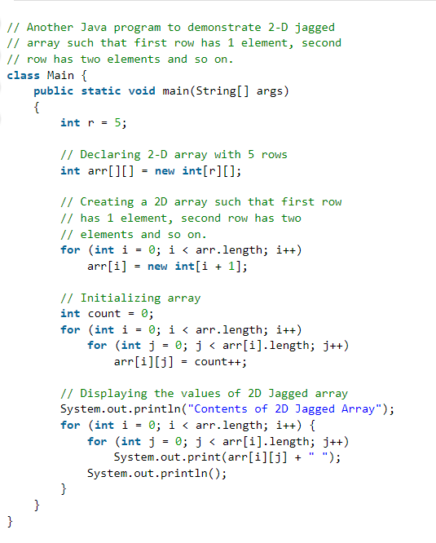
nested for loop
// loop through each row of the jagged array
// loop through each column of the current row

Slide 124
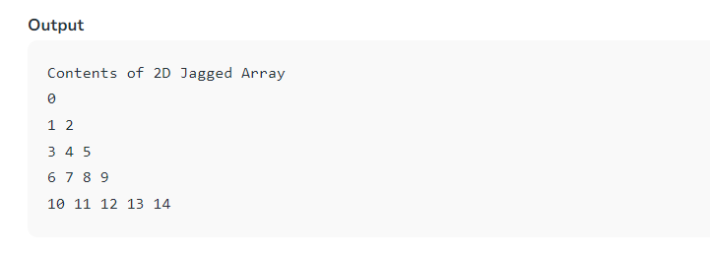

Slide 125
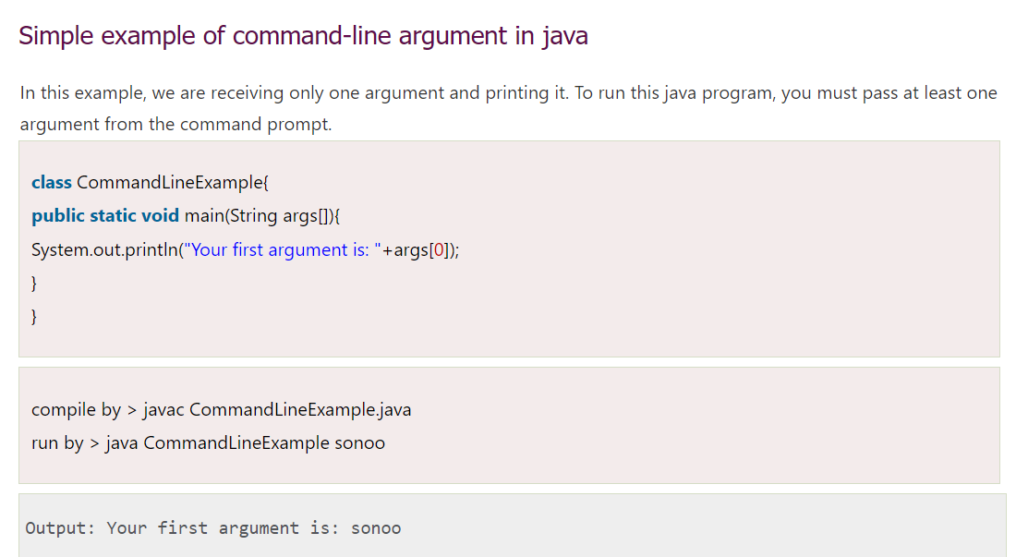
Java Command Line Arguments
The java command-line argument is an argument i.e. passed at the time of running the java program. The arguments passed from the console i.e., command prompt (not on Online Compilers) can be received in the java program and it can be used as an input. So, it provides a convenient way to check the behavior of the program for the different values.

Slide 126
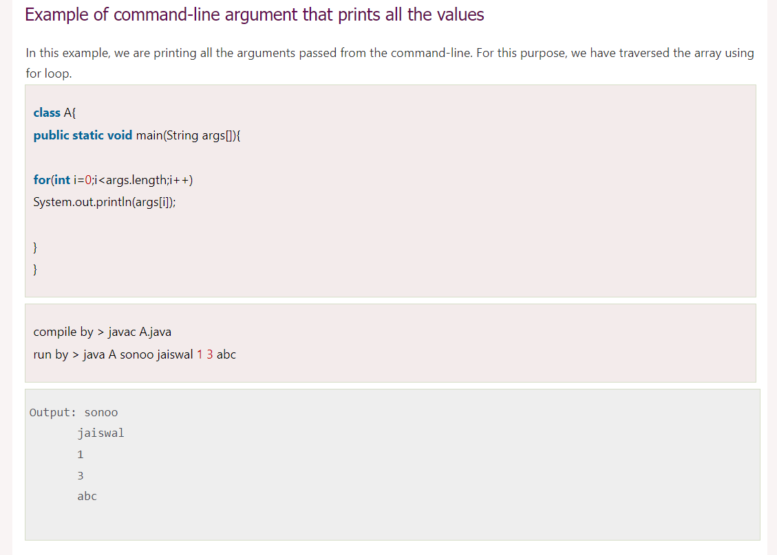

Slide 127
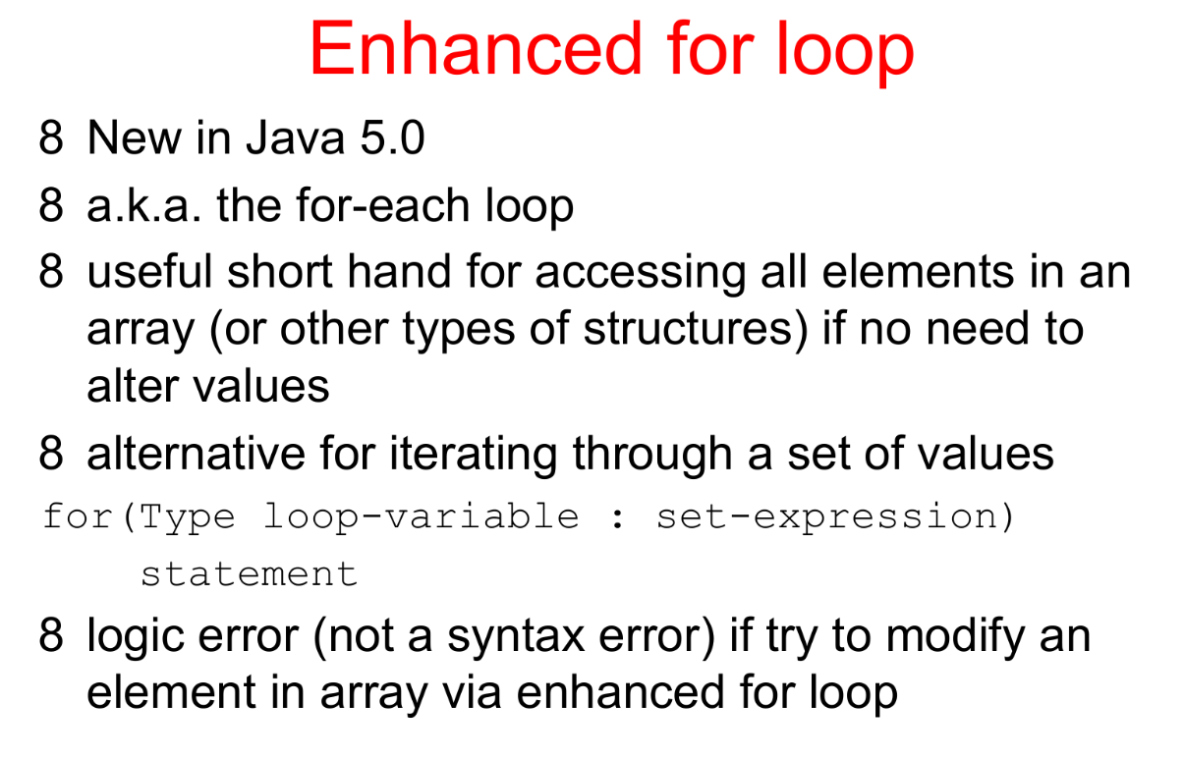

Slide 128
For-each loop with Array in Java
For-each is another array traversing technique like for loop, while loop, do-while loop introduced in Java5.
It starts with the keyword for like a normal for-loop.
Instead of declaring and initializing a loop counter variable, you declare a variable that is the same type as the base type of the array, followed by a colon, which is then followed by the array name.
In the loop body, you can use the loop variable you created rather than using an indexed array element.
It’s commonly used to iterate over an array or a Collections class (eg, ArrayList)

Slide 129
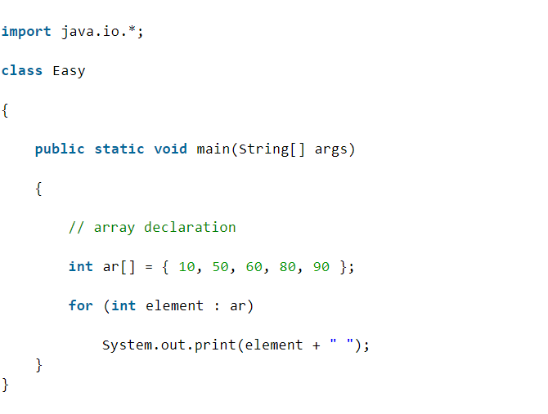
Syntax:
for (type var : array)
{
statements using var;
}
EXAMPLE
The above syntax is equivalent to:
for (int i=0; i<arr.length; i++)
{
type var = arr[i];
statements using var;
}
OUTPUT
10 50 60 80 90

Slide 130
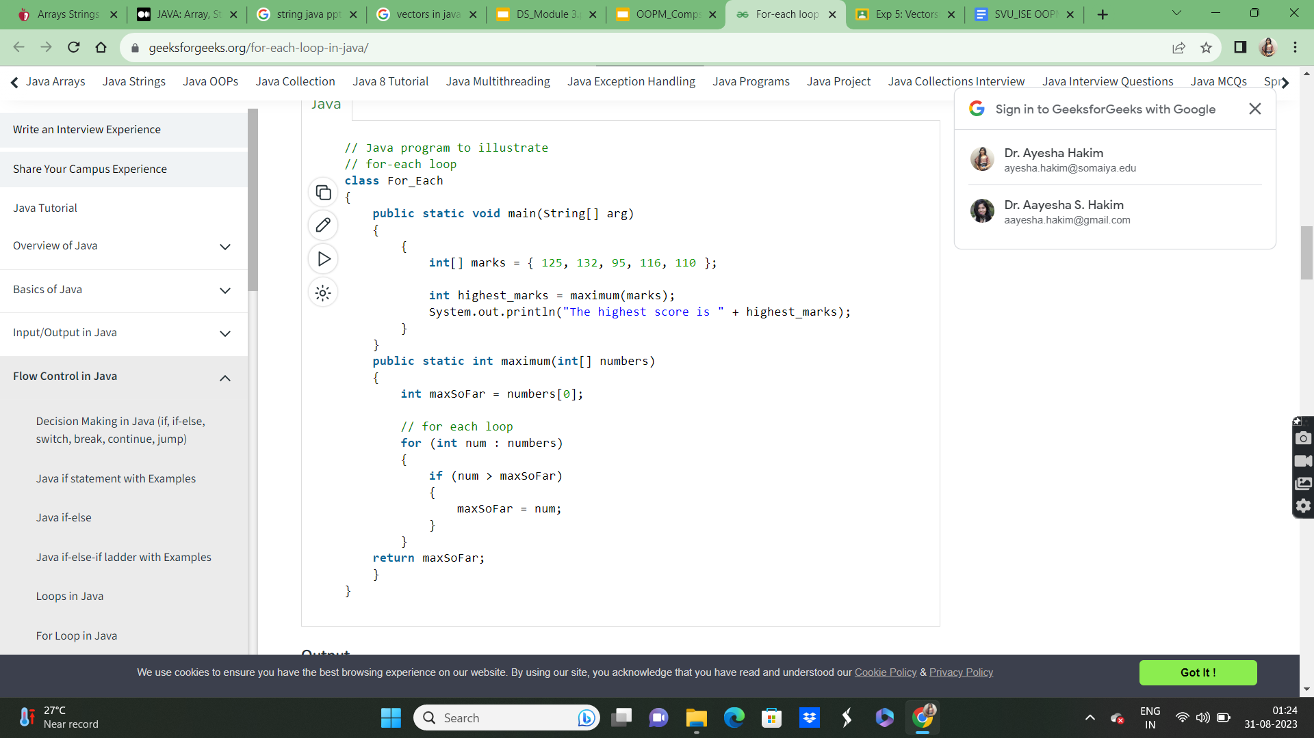
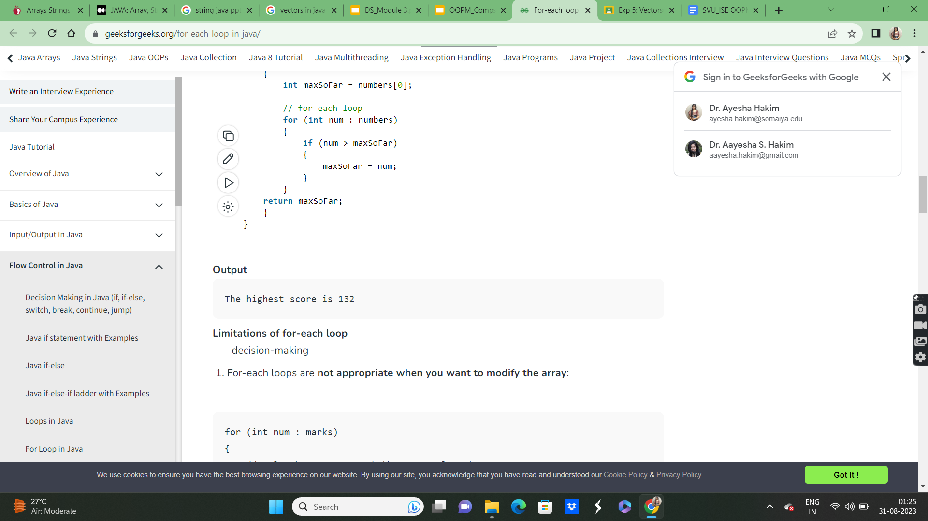
https://www.geeksforgeeks.org/for-each-loop-in-java/
https://www.javatpoint.com/java-arraylist

Slide 131
ArrayList in Java
The ArrayList class is a resizable array, which can be found in the java.util package.
The difference between a built-in array and an ArrayList in Java, is that the size of an array cannot be modified (if you want to add or remove elements to/from an array, you have to create a new one). While elements can be added and removed from an ArrayList whenever you want.
Example
Create an ArrayList object called cars that will store strings:
import java.util.ArrayList; // import the ArrayList class
ArrayList<String> cars = new ArrayList<String>(); // Create an ArrayList object

Slide 132
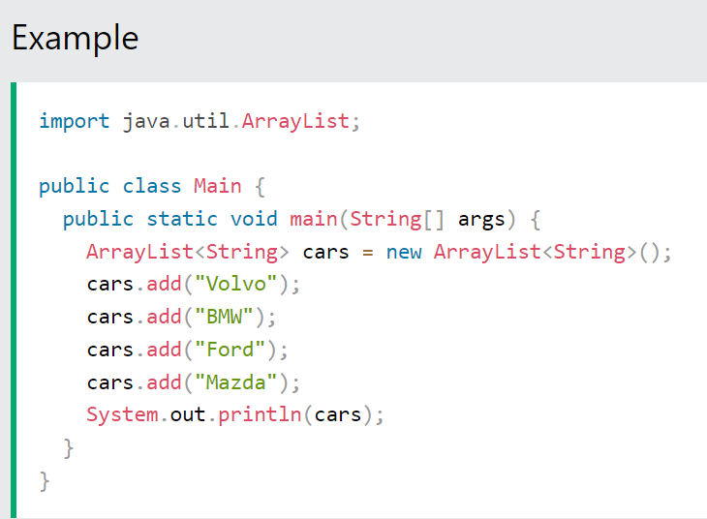
Add Items
The ArrayList class has many useful methods. For example, to add elements to the ArrayList, use the add() method:
OUTPUT:
[Volvo, BMW, Ford, Mazda]

Slide 133
For more on ArrayList refer:
https://www.w3schools.com/java/java_arraylist.asp

Slide 134
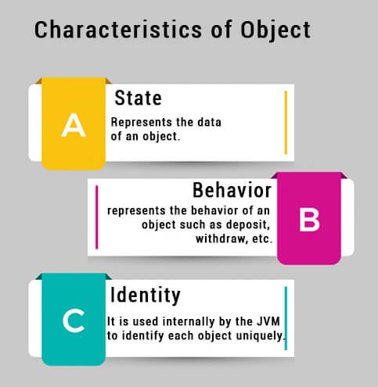
Objects in Java
An entity that has state and behavior is known as an object e.g., chair, bike, marker, pen, table, car, etc. An object is an instance of a class. A class is a template or blueprint from which objects are created. So, an object is the instance(result) of a class.
In Java, when we only declare a variable of a class type, only a reference is created (memory is not allocated for the object). To allocate memory to an object, we must use new().
An object has three characteristics:
State: represents the data (value) of an object.
Behavior: represents the behavior (functionality) of an object such as deposit, withdraw, etc.
Identity: An object identity is typically implemented via a unique ID. The value of the ID is not visible to the external user. However, it is used internally by the JVM to identify each object uniquely.

Slide 135
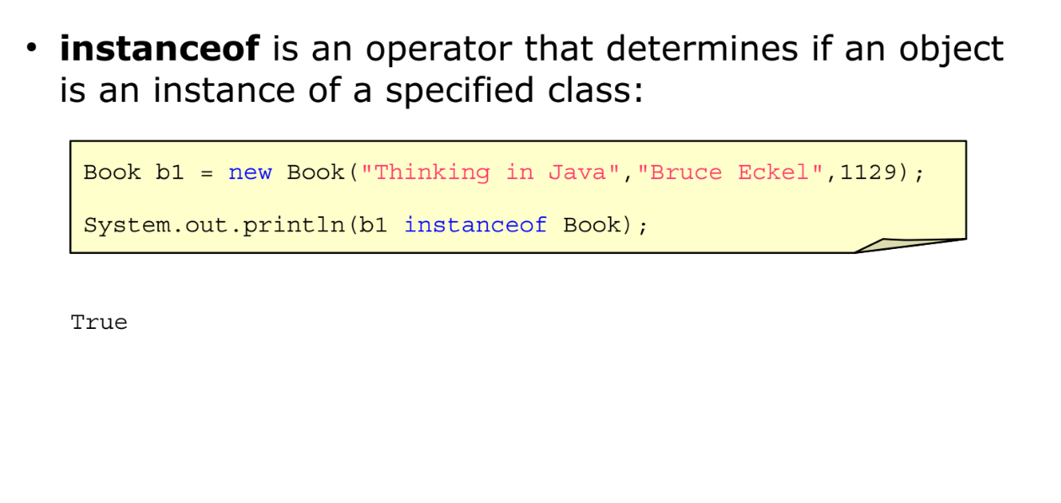
instanceof operator
The instanceof in java is also known as type comparison operator because it compares the instance with type. It returns either true or false. If we apply the instanceof operator with any variable that has null value, it returns false.

Slide 136
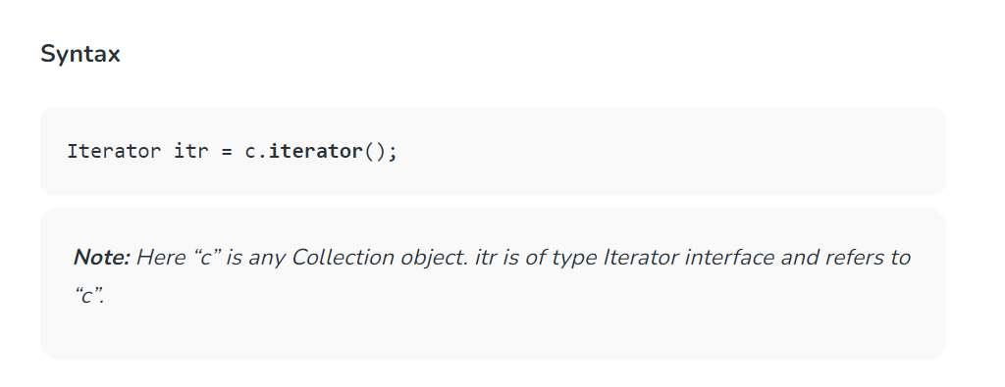
Java Iterator
An Iterator is an object that can be used to loop through collections, like ArrayList and HashSet. It is called an "iterator" because "iterating" is the technical term for looping.
To use an Iterator, you must import it from the java.util package.
The iterator() method can be used to get an Iterator for any collection.

Slide 137
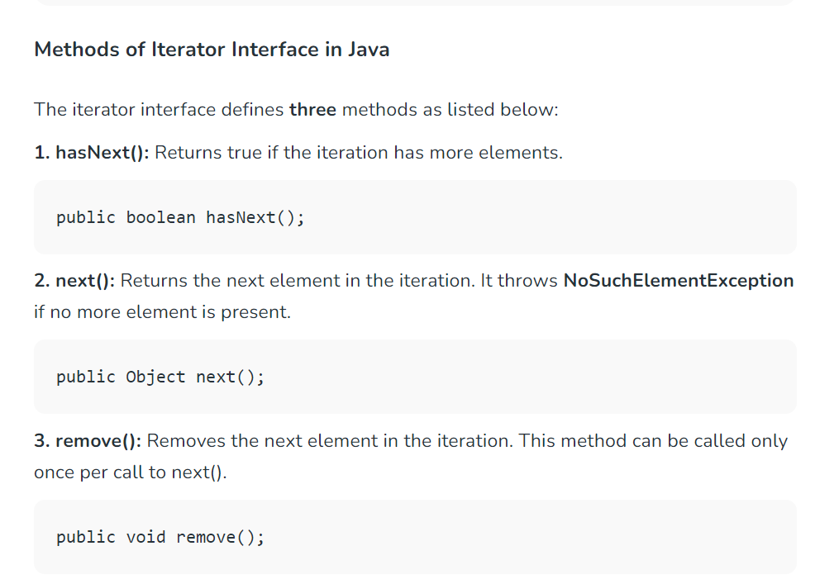

Slide 138
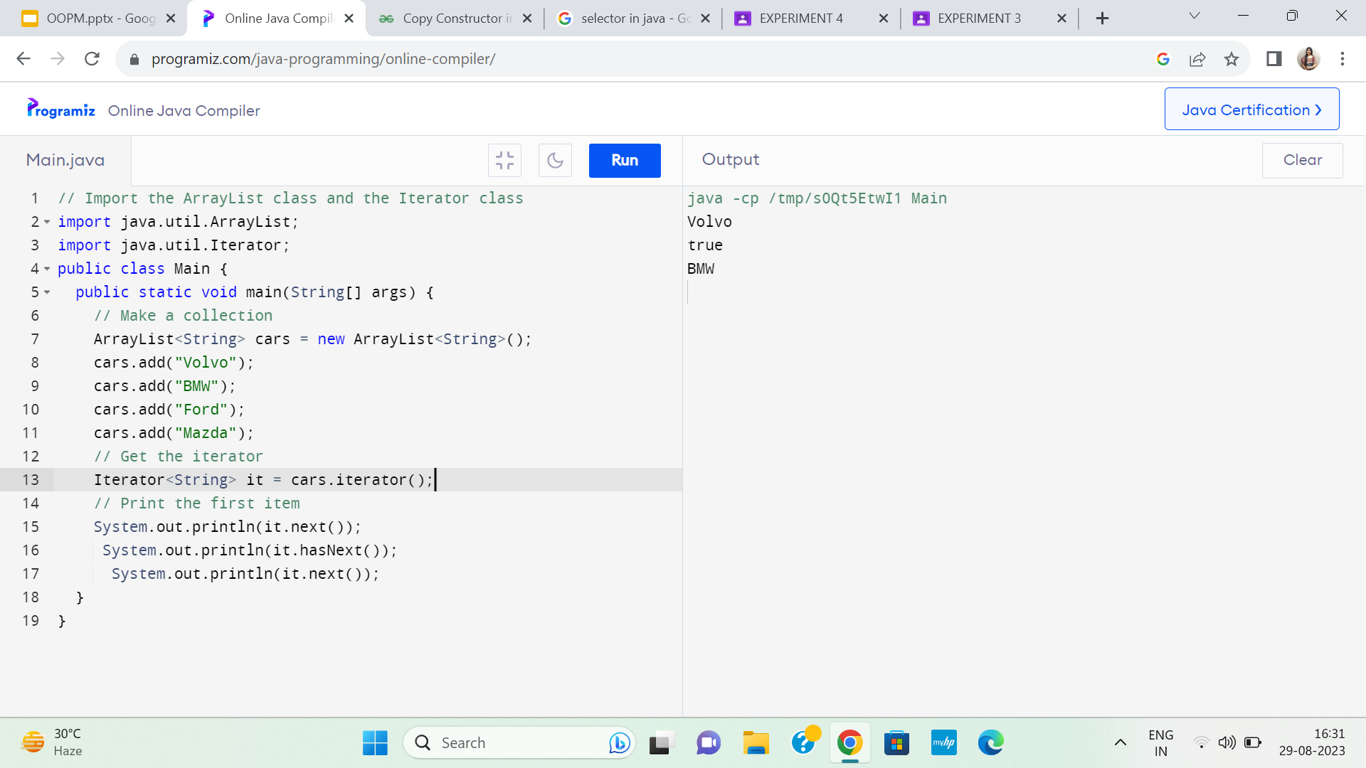
//check if iterator has the elements
//printing the element and move to next

Slide 140
Vectors
Notes:
140

Slide 141
A Weakness of Arrays
Suppose we declare an array of “Student” objects:
Student[] students = new Student[10];
What if a new student joins the class?
The size of an array cannot be increased after it is instantiated
Java Programming: Program Design Including Data Structures
141

Slide 142
Resizing an Array (the hard way)
Student[] students = new Student[10];
// do some stuff…
// now we need to add student 11
Student[] students2 = new Student[11];
for(int i = 0; i < students.length; i++) {
students2[i] = students[i];
}
student[10] = new Student();
Java Programming: Program Design Including Data Structures
142

Slide 143
VECTORS
In Java the concept of variable arguments to a function is achieved by the use of Vector class contained in the java.util package.
This class can be used to create a generic dynamic array known as vector that can hold objects of any type and any number.
The objects in this do not have to be homogenous.
Array can be easily implemented as vectors.

Slide 144
VECTORS ARE CREATED AS ARRAY AS FOLLOWS:
Vector intVect = new Vector( ); // declaring without size
Vector list = new Vector(3); // declaring with size
A vector can be declared without specifying any size explicitly.
A vector can accommodate an unknown number of items. Even, when a size is specified, this can be overlooked and a different number of items may be put into the vector.

Slide 145
ADVANTAGES OF VECTOR OVER ARRAYS
🡪 It is convenient to use vectors to store objects.
A vector can be used to store a list of objects that may vary in size.
We can add and delete objects from the list as and when required.
DISADVANTAGES OF VECTOR OVER ARRAYS
🡪We cannot directly store simple data types in a vector.
🡪We can only store objects. Therefore , we need to convert
Simple types to objects. This can be done using the wrapper classes

Slide 146
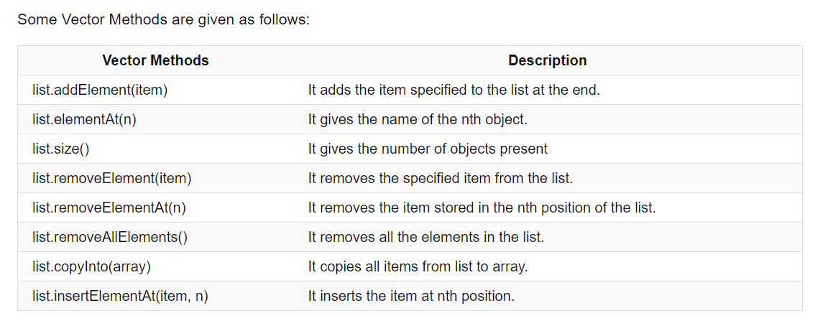

Slide 147
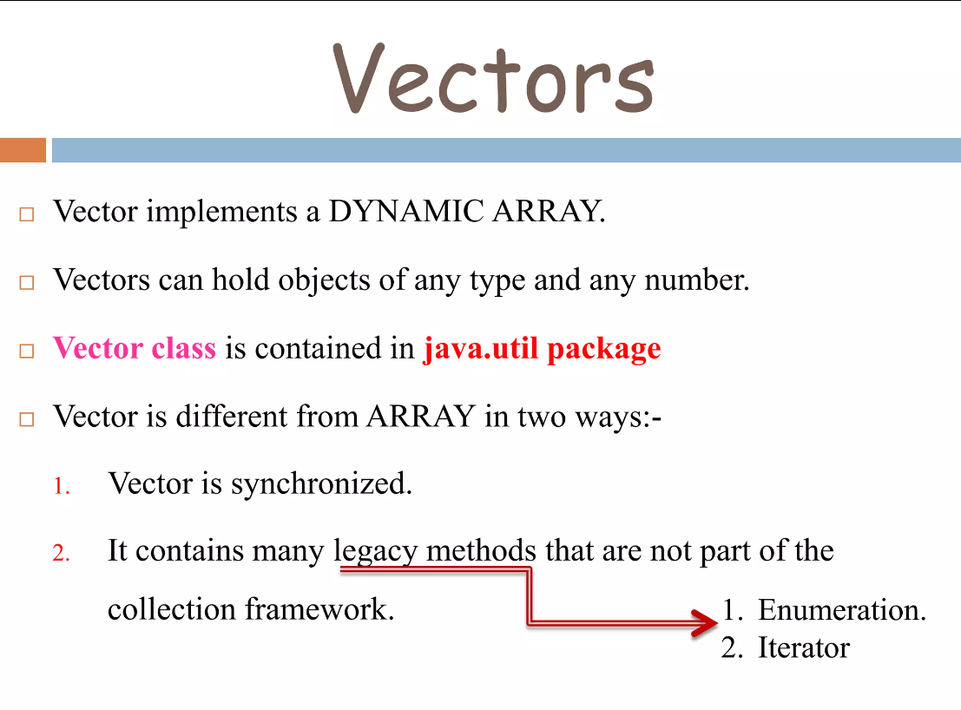

Slide 148


Slide 149


Slide 150


Slide 151


Slide 152

examples: https://www.programiz.com/java-programming/vector#google_vignette

Slide 153
More on Vectors:
https://www.upgrad.com/blog/vector-in-java/
https://www.scaler.com/topics/java/vector-in-java/

Slide 154

Code: https://www.geeksforgeeks.org/java-program-to-iterate-vector-using-enumeration/

Slide 155
Using Iterator to Iterate over Vector Elements
Code: https://www.geeksforgeeks.org/iterate-over-vector-elements-in-java/
https://www.geeksforgeeks.org/difference-between-iterator-and-enumeration-in-java-with-examples/
https://www.geeksforgeeks.org/java-util-vector-class-java/
https://www.geeksforgeeks.org/java-program-to-iterate-vector-using-enumeration/
https://www.geeksforgeeks.org/enumeration-interface-in-java/
Comparator Interface for Sorting: https://www.geeksforgeeks.org/comparator-interface-java/

Slide 156
Codes Link
https://docs.google.com/document/d/1tM6La9VpnZNpBbQ9tcV11IMaogQTkrpxjKrWp1_O1EU/edit?usp=sharing

Slide 157
WRAPPER CLASSES
Since, vectors cannot handle primitive data types like int, float, long ,char, and double.
Primitive data types may be converted into object types by using the wrapper classes contained in the java.lang packages.
The wrapper classes have a number of unique methods for handling primitive data types and objects.

Slide 158
WRAPPER CLASSES FOR CONVERTING SIMPLE TYPES
Simple Type
Wrapper Class
boolean
Boolean
char
Character
double
Double
float
Float
int
Integer
long
Long
https://www.geeksforgeeks.org/wrapper-classes-java/

Slide 159
Tutorial Activity : for-each loop, ArrayList, Iterator, Vectors, 'super' keyword
1. WAJP using a for-each loop to print the lowest marks in an array storing marks of 10 students.
2. WAJP to traverse ArrayList elements (store names of 5 fruits) using the Iterator interface. Also demonstrate the use of add(), get() and set() methods.

Slide 160
Tutorial Activity : for-each loop, ArrayList, Iterator, Vectors, 'super' keyword
3. WAJP that accepts a shopping list of 5 items from the command line and stores them in a vector. Modify the program to accomplish the following:
a. delete an item in the list
b. add an item at a specified position in list
c. add an item at the end of list
d. print the contents of the vector
4. Demonstrate the use of 'super' keyword using a Java program. Here, Employee class (store 'salary' here) should inherit Person class, so all the properties (id, name) of Person should be inherited to Employee by default. To initialize all the properties, use parent class constructor from child class. Display id, name and salary of 3 employees as an output.

Slide 161
Sample Solutions to Tutorial Questions

Slide 162
class Vector
The class Vector can be used to implement a list, replacing a simple array
The size of a Vector object can grow/shrink during program execution
The Vector will automatically grow to accommodate the number of elements you put in it
Java Programming: Program Design Including Data Structures
162
Notes:
162

Slide 163
class Vector (continued)
The class Vector is contained in the package java.util
Programs must include either:
import java.util.*;
import java.util.Vector;
Java Programming: Program Design Including Data Structures
163
Notes:
163

Slide 164
Vector Declaration
Declare/initialize
Vector<Student> students = new Vector<Student>();
The syntax <…> is used to declare the type of object that will be stored in the Vector
If you add a different type of object, an exception is thrown
Not strictly necessary, but highly recommended (compiler warning)
Java Programming: Program Design Including Data Structures
164

Slide 165
Vector Size/Capacity
The size of a vector is the number of elements
The capacity of a vector is the maximum number of elements before more memory is needed
If size exceeds capacity when adding an element, the capacity is automatically increased
Declares a larger storage array
Copies existing elements, if necessary
Growing the capacity is expensive!
By default, the capacity doubles each time
Java Programming: Program Design Including Data Structures
165

Slide 166
Setting Initial Capacity
If you know you will need a large vector, it may be faster to set the initial capacity to something large
Vector<Student> students = new Vector<Student>(1000);
Java Programming: Program Design Including Data Structures
166

Slide 167
Size and capacity
Get the current size and capacity:
Vector<Student> students = new Vector<Student>(1000);
students.size(); // returns 0
students.capacity(); // returns 1000
Setting size and capacity:
// adds null elements or deletes elements if necessary
students.setSize(10);
// increases capacity if necessary
students.ensureCapacity(10000);
Java Programming: Program Design Including Data Structures
167

Slide 168

Adding Elements
Vector<String> stringList = new Vector<String>();
stringList.add("Spring");
stringList.add("Summer");
stringList.addElement("Fall");
stringList.addElement("Winter");
add and addElement
have identical functionality
Java Programming: Program Design Including Data Structures
168
Notes:
168

Slide 169
Accessing Elements
stringList.get(0); // “Spring”
stringList.get(3); // “Winter”
stringList.get(4); // ArrayIndexOutOfBounds Exception
Java Programming: Program Design Including Data Structures
169
Notes:
169

Slide 170
Primitive Data Types and the class Vector
Every component of a Vector object is a reference
Primitive data types are not objects
Corresponding to each primitive data type, Java provides a wrapper class
JDK 5.0 provides autoboxing and auto-unboxing of primitive data types
Java Programming: Program Design Including Data Structures
170
Notes:
170

Slide 171
Autoboxing and Unboxing
1. Autoboxing
The automatic conversion of primitive types to the object of their corresponding wrapper classes is known as autoboxing. For example – conversion of int to Integer, long to Long, double to Double, etc.
2. Unboxing
It is just the reverse process of autoboxing. Automatically converting an object of a wrapper class to its corresponding primitive type is known as unboxing. For example – conversion of Integer to int, Long to long, Double to double, etc.

Slide 172


Slide 173


Slide 174
Primitive Data Types and the class Vector (continued)
Creating a Vector of Integer objects
Vector<Integer> list = new Vector<Integer>();
list.add(13); // with autoboxing
list.add(new Integer(25)); // without autoboxing
int tmp = list.get(0); // with autounboxing
int tmp2 = list.get(0).intValue() //without
Java Programming: Program Design Including Data Structures
174
Notes:
174

Slide 175
Vector and the foreach loop
Each Vector object is a collection of elements
You can use a foreach loop to process its elements
Exactly like using a foreach loop with an array
Syntax:
for (type identifier : vectorObject)
statements
Java Programming: Program Design Including Data Structures
175
Notes:
175

Slide 176

Members of the class Vector
Java Programming: Program Design Including Data Structures
176
Notes:
176

Slide 177

Members of the class Vector (continued)
Java Programming: Program Design Including Data Structures
177
Notes:
177

Slide 178

Members of the class Vector (continued)
Java Programming: Program Design Including Data Structures
178
Notes:
178

Slide 179

Members of the class Vector (continued)
Java Programming: Program Design Including Data Structures
179
Notes:
179

Slide 180
Strings
Strings are essentially arrays of characters
Strings in Java are immutable and final
The string class provides many functions for manipulating strings
Searching/matching operations
Replacing characters
Finding characters
Trimming whitespace
Etc.
Java Programming: Program Design Including Data Structures
180

Slide 181


Slide 182


Slide 183


Slide 184


Slide 185


Slide 186


Slide 187


Slide 188


Slide 189


Slide 190

https://www.geeksforgeeks.org/substring-in-java/

Slide 191


Slide 192


Slide 193


Slide 194


Slide 195


Slide 196


Slide 197


Slide 198


Slide 199

class String (Revisited)
Java Programming: Program Design Including Data Structures
199
Notes:
199

Slide 200

class String (Revisited) (continued)
Java Programming: Program Design Including Data Structures
200
Notes:
200

Slide 201

class String (Revisited) (continued)
Java Programming: Program Design Including Data Structures
201
Notes:
201

Slide 202

class String (Revisited) (continued)
https://learnprogramo.com/menu-driven-program-in-java-program-with-explanation/
Java Programming: Program Design Including Data Structures
202
Notes:
202

Slide 203
Java toString() Method
https://www.geeksforgeeks.org/string-tostring-method-in-java/

Slide 204
StringBuilder Class
https://www.geeksforgeeks.org/stringbuilder-class-in-java-with-examples/
https://www.javatpoint.com/StringBuilder-class

Slide 205
STRINGS
The simplest way to represent a sequence of characters in java is by using a character array.
Example:
char charArray[ ] = new char[4];
charArray[0] = ‘J’;
charArray[1] = ‘a’;

Slide 206
In Java, strings are class objects and implemented using two classes,namely, String and StringBuffer.
A java string is an instantiated object of the String class.

Slide 207
DECLARATION OF STRING
String stringName;
StringName = new String (“string”);
Example:
String firstName;
firstName = new String(“Anil”);

Slide 208
STRING ARRAYS
Array can be created and used that contain strings.
Above statement create following effects:
String itemArray[ ] = new String [3];
An itemArray of size 3 to hold three string constants.
Strings can be assign to itemArray element:-
•using three different statements
• more efficiently using a for loop

Slide 209
STRING METHODS
String class defines a number of methods that allow us to accomplish a variety of string manipulation tasks.
STRING BUFFER CLASS
StringBuffer is a peer class of String.
While String creates strings of fixed_length, StringBuffer creates strings of flexible length that can be modified in term of both length and content.
We can insert characters and substrings in the middle of a string to the end.

Slide 210

The String Class
The String class defines a data type that is used to store a sequence of characters
You cannot modify a String object
If you attempt to do so, Java will create a new object that contains the modified character sequence

Slide 211


Comparing Objects
You can’t use the relational or equality operators to compare the values stored in strings (or other objects)
(You will compare the pointers, not the objects!)

Slide 212

The StringBuffer Class
Stores character sequences
Unlike a String object, you can change the contents of a StringBuffer object

Slide 213
Write a Java program to find the longest Palindromic Substring within a string.
Sol. https://www.w3resource.com/java-exercises/string/java-string-exercise-32.php
Logic: https://www.geeksforgeeks.org/longest-palindromic-substring/
https://www.geeksforgeeks.org/longest-palindromic-substring-using-dynamic-programming-2/
https://docs.google.com/document/d/1tM6La9VpnZNpBbQ9tcV11IMaogQTkrpxjKrWp1_O1EU/edit?usp=sharing

Slide 214
Selector
selector
(or method selector) a word (e.g., draw) that performs an operation on a variety classes. A selector describes what operation to perform.
selector invocation
a call of a selector. One argument of the call is used for determining which method is used. i.e., a message (consisting of the selector and the other arguments) is sent to the object.
receiving object
the object used for determining the method executed by a selector invocation.

Slide 215

Access Modifiers in Java
The access modifiers in Java specifies the accessibility or scope of a field, method, constructor, or class. We can change the access level of fields, constructors, methods, and class by applying the access modifier on it.

Slide 216

The public keyword is an access modifier, meaning that it is used to set the access level for classes, attributes, methods and constructors.
We divide modifiers into two groups:
Access Modifiers - controls the access level
Non-Access Modifiers - do not control access level, but provides other functionality

Slide 217


Slide 218


Slide 219


Slide 220
The super Reference
Constructors are not inherited, even though they have public visibility
Yet we often want to use the parent's constructor to set up the "parent's part" of the object
The super reference can be used to refer to the parent class, and often is used to invoke the parent's constructor

Slide 221
The super Reference
A child’s constructor is responsible for calling the parent’s constructor
The first line of a child’s constructor should use the super reference to call the parent’s constructor
The super reference can also be used to reference other variables and methods defined in the parent’s class

Slide 222


Slide 223


Slide 224


Slide 225


Slide 226
The super keyword in Java
super keyword is similar to this keyword in Java.
It is used to refer to the immediate parent class of the object.
Use of super keyword in Java
super () calls the parent class constructor with no argument.
super.methodname calls method from parents class.
It is used to call the parents class variable.

Slide 227


Slide 228


Slide 229
this keyword
The keyword “this” is used in an instance method to refer to the object that contains the method, i.e. the it refers to the current object.
Whenever and wherever, a reference to an object of the current class type is required, ‘this’ can be used.
It has two other usages:
Differentiating between instance variables and local variables
Constructor chaining
https://www.javatpoint.com/this-keyword

Slide 230
this keyword (contd.)
To differentiate between Instance variables and local variables
Room2( double l, double b, double h) {
this.length = l;
this.breadth = b;
this.height = h;
}

Slide 231
Constructor chaining
It means a constructor can be called from another constructor.
/*First Const.*/ Room2()
{
// constructor chained
this(14,12,10);
}
/*Second Const.*/ Room2( double l, double b, double h) {
length = l;
breadth = b;
height = h;
}

Slide 232
Java Garbage Collection
In java, garbage means unreferenced objects.
Garbage Collection is process of reclaiming the runtime unused memory automatically. In other words, it is a way to destroy the unused objects.
To do so, we were using free() function in C language and delete() in C++. But, in java it is performed automatically. So, java provides better memory management.

Slide 233
Cleaning up unused object
Java allows a programmer to create as many objects as he/she wants but frees him/her from worrying about destroying them. The Java runtime environment deletes objects when it determines that they are no longer required.
The Java runtime environment has a garbage collector that periodically frees the memory used by objects that are no longer needed.
Before an object gets garbage collected, the garbage collector gives the object an opportunity to clean up itself through a call to the object's finalize() method. This process is known as finalization.
https://www.javatpoint.com/Garbage-Collection

Slide 234
Garbage Collector
Two basic approaches :
Reference counting and
tracing.
Reference counting maintains a reference count for every object.
It is incremented and decremented as and when the references on objects increase or decrease (leave an object)
When reference count for a particular object is 0, the object can be garbage collected.

Slide 235
Garbage Collector (contd.)
Tracing technique traces the entire set of objects (starting from root) and all objects having reference on them are marked in some way.
a.k.a mark and sweep garbage
The objects that are not marked (not referenced) are assumed to be garbage and their memory is reclaimed.

Slide 236
Garbage Collector (contd.)
Mark and sweep collectors further use the techniques of Compaction and Copying for fragmentation problems that may arise once you sweep the unreferenced objects.
Compaction moves all the live objects towards one end making the other end a large free space and copying techniques copies all live objects besides each other into a new space and the old space is considered free now.

Slide 237
Advantages
Free From worrying about deallocation of memory
Helps in ensuring integrity of programs.
No way by which Java programmers can knowingly or unknowingly free memory incorrectly.
It makes java memory efficient because garbage collector removes the unreferenced objects from heap memory.
It is automatically done by the garbage collector(a part of JVM) so we don't need to make extra efforts.

Slide 238
Disadvantages
overhead to keep track of which objects are being referenced by the executing program and which are not being referenced
overhead is also incurred on finalization and freeing memory of the unreferenced objects.
These activities will incur more CPU time than would have been incurred if the programmers would have explicitly deallocated memory.

Slide 239


Slide 240


Slide 241


Slide 242


Slide 243


Slide 244
Example: Sample program for final keyword in Java
class FinalVarDemo
{
final int a = 10;
void show()
{
a = 20;
System.out.println("a : "+a);
}
public static void main(String args[])
{
FinalVarDemo var = new FinalVarDemo();
var.show();
}
}
The final keyword in Java
The final keyword in Java indicates that no further modification is possible. Final can be Variable, Method or Class
Final Variable
Final variable is a constant. We cannot change the value of final variable after initialization.
Output:
Compile time error

Slide 245
The Final Modifier (Inheritance)
Methods preceded by the final modifier cannot be overridden
e.g., public final void displayTwo ()
Classes preceded by the final modifier cannot be extended
e.g., final public class ParentFoo

Slide 246
Final method
When we declare any method as final, it cannot be overriden.
Example: Sample program for final method in Java
class Animal
{
final void eat()
{
System.out.println("Animals are eating");
}
}
public class Dear extends Animal
{
void eat()
{
System.out.println("Dear is eating");
}
public static void main(String args[])
{
Dear dear = new Dear();
dear.eat();
}
}
Output:
Compile time error

Slide 247
Final Class
When a class is declared as a final, it cannot be extended.
Example: Sample program for final class in Java
final class Animal
{
void eat()
{
System.out.println("Animals are eating");
}
}
class Dear extends Animal
{
void eat()
{
System.out.println("Dear is eating");
}
public static void main(String args[])
{
Dear dear = new Dear();
dear.eat();
}
}
Output:
Compile time error

Slide 248

https://www.javatpoint.com/final-keyword

Slide 249
Characteristics of final keyword in java:
In Java, the final keyword is used to indicate that a variable, method, or class cannot be modified or extended. Here are some of its characteristics:
Final variables: When a variable is declared as final, its value cannot be changed once it has been initialized. This is useful for declaring constants or other values that should not be modified.
Final methods: When a method is declared as final, it cannot be overridden by a subclass. This is useful for methods that are part of a class’s public API and should not be modified by subclasses.
Final classes: When a class is declared as final, it cannot be extended by a subclass. This is useful for classes that are intended to be used as is and should not be modified or extended.
Initialization: Final variables must be initialized either at the time of declaration or in the constructor of the class. This ensures that the value of the variable is set and cannot be changed.
Performance: The use of final can sometimes improve performance, as the compiler can optimize the code more effectively when it knows that a variable or method cannot be changed.
Security: final can help improve security by preventing malicious code from modifying sensitive data or behavior.

Slide 250
Classes ARE Object Definitions
OOP - object oriented programming
code built from objects
Java these are called classes
Each class definition is coded in a separate .java file
Name of the object must match the class/object name

Slide 251
The three principles of OOP
Encapsulation
Objects hide their functions (methods) and data (instance variables)
Inheritance
Each subclass inherits all variables of its superclass
Polymorphism
Interface same despite different data types
car
Super class
manual
auto-
matic
Subclasses
draw()
draw()

Slide 252
Simple Class and Method
Class Fruit{
int grams;
int cals_per_gram;
int total_calories() {
return(grams*cals_per_gram);
}
}

Slide 253
Methods
A method is a named sequence of code that can be invoked by other Java code.
A method takes some parameters, performs some computations and then optionally returns a value (or object).
Methods can be used as part of an expression statement.
public float convertCelsius(float tempC) {
return( ((tempC * 9.0f) / 5.0f) + 32.0 );
}

Slide 254
Method Signatures
A method signature specifies:
The name of the method.
The type and name of each parameter.
The type of the value (or object) returned by the method.
The checked exceptions thrown by the method.
Various method modifiers.
modifiers type name ( parameter list ) [throws exceptions ]
public float convertCelsius (float tCelsius ) {}
public boolean setUserInfo ( int i, int j, String name ) throws IndexOutOfBoundsException {}

Slide 255
Public/private
Methods/data may be declared public or private meaning they may or may not be accessed by code in other classes …
Good practice:
keep data private
keep most methods private
well-defined interface between classes - helps to eliminate errors

Slide 256
Using objects
Here, code in one class creates an instance of another class and does something with it …
Fruit plum=new Fruit();
int cals;
cals = plum.total_calories();
Dot operator allows you to access (public) data/methods inside Fruit class

Slide 257
Constructors
The line
plum = new Fruit();
invokes a constructor method with which you can set the initial data of an object
You may choose several different type of constructor with different argument lists
eg Fruit(), Fruit(a) ...

Slide 258
Overloading
Can have several versions of a method in class with different types/numbers of arguments
Fruit() {grams=50;}
Fruit(a,b) { grams=a; cals_per_gram=b;}
By looking at arguments Java decides which version to use

Slide 259
Java Development Kit (JDK)
javac - The Java Compiler
java - The Java Interpreter
jdb - The Java Debugger
appletviewer -Tool to run the applets
javap - to print the Java bytecodes
javaprof - Java profiler
javadoc - documentation generator
javah - creates C header files

Slide 260


Slide 261
Some Salient Characteristics of Java
Java is platform independent: the same program can run on any correctly implemented Java system
Java is object-oriented:
Structured in terms of classes, which group data with operations on that data
Can construct new classes by extending existing ones
Java designed as
A core language
A rich collection of commonly available packages
Java can be embedded in Web pages

Slide 262
Java Processing and Execution
Begin with Java source code in text files: Model.java
A Java source code compiler produces Java byte code
Outputs one file per class: Model.class
May be standalone or part of an IDE
A Java Virtual Machine loads and executes class files
May compile them to native code (e.g., x86) internally

Slide 263

Compiling and Executing a Java Program

Slide 264
Classes and Objects
The class is the unit of programming
A Java program is a collection of classes
Each class definition (usually) in its own .java file
The file name must match the class name
A class describes objects (instances)
Describes their common characteristics: is a blueprint
Thus all the instances have these same characteristics
These characteristics are:
Data fields for each object
Methods (operations) that do work on the objects

Slide 265
Grouping Classes: The Java API
API = Application Programming Interface
Java = small core + extensive collection of packages
A package consists of some related Java classes:
Swing: a GUI (graphical user interface) package
AWT: Application Window Toolkit (more GUI)
util: utility data structures
The import statement tells the compiler to make available classes and methods of another package
A main method indicates where to begin executing a class (if it is designed to be run as a program)

Slide 266
A Little Example of import and main
import javax.swing.*;
// all classes from javax.swing
public class HelloWorld { // starts a class
public static void main (String[] args) {
// starts a main method
// in: array of String; out: none (void)
}
}
public = can be seen from any package
static = not “part of” an object

Slide 267

Processing and Running HelloWorld
javac HelloWorld.java
Produces HelloWorld.class (byte code)
java HelloWorld
Starts the JVM and runs the main method

Slide 268
Names & Identifiers
You must give your program a name.
public class GangstaRap {
Naming convention: capitalize each word (e.g. MyClassName)
Your program's file must match exactly (GangstaRap.java)
includes capitalization (Java is "case-sensitive")

Slide 269

Keywords in Java

Slide 270


Slide 271


Slide 272
References and Primitive Data Types
Java distinguishes two kinds of entities
Primitive types
Objects
Primitive-type data is stored in primitive-type variables
Reference variables store the address of an object

Slide 273
Primitive Data Types
Represent numbers, characters, boolean values
Integers: byte, short, int, and long
Real numbers: float and double
Characters: char

Slide 274
Primitive Data Types
Data type
Range of values
byte
-128 .. 127 (8 bits)
short
-32,768 .. 32,767 (16 bits)
int
-2,147,483,648 .. 2,147,483,647 (32 bits)
long
-9,223,372,036,854,775,808 .. ... (64 bits)
float
+/-10⁻³⁸ to +/-10⁺³⁸ and 0, about 6 digits precision
double
+/-10⁻³⁰⁸ to +/-10⁺³⁰⁸ and 0, about 15 digits precision
char
Unicode characters (generally 16 bits per char)
boolean
True or false

Slide 275
Operators
subscript [ ], call ( ), member access .
pre/post-increment ++ --, boolean complement !, bitwise complement ~, unary + -, type cast (type), object creation new
* / %
binary + - (+ also concatenates strings)
signed shift << >>, unsigned shift >>>
comparison < <= > >=, class test instanceof
equality comparison == !=
bitwise and &
bitwise or |

Slide 276
Operators
logical (sequential) and &&
logical (sequential) or ||
conditional cond ? true-expr : false-expr
assignment =, compound assignment += -= *= /= <<= >>= >>>= &= |=

Slide 277
Type Compatibility and Conversion
Widening conversion:
In operations on mixed-type operands, the numeric type of the smaller range is converted to the numeric type of the larger range
In an assignment, a numeric type of smaller range can be assigned to a numeric type of larger range
byte to short to int to long
int to float to double

Slide 278
Declaring and Setting Variables
int square;
square = n * n;
double cube = n * (double)square;
Can generally declare local variables where they are initialized
All variables get a safe initial value anyway (zero/null)

Slide 279

Referencing and Creating Objects
You can declare reference variables
They reference objects of specified types
Two reference variables can reference the same object
The new operator creates an instance of a class
Example: String greeting = ″hello″;

Slide 280
Java Control Statements
A group of statements executed in order is written
{ stmt1; stmt2; ...; stmtN; }
The statements execute in the order 1, 2, ..., N
Control statements alter this sequential flow of execution

Slide 281

Java Control Statements (continued)

Slide 282

Java Control Statements (continued)

Slide 283
Methods
A Java method defines a group of statements as performing a particular operation
static indicates a static or class method
All method arguments are call-by-value
Primitive type: value is passed to the method
Method may modify local copy but will not affect caller’s value
Object reference: address of object is passed
Change to reference variable does not affect caller
But operations can affect the object, visible to caller

Slide 284

The Class Math

Slide 285

Escape Sequences
An escape sequence is a sequence of two characters beginning with the character \
A way to represents special characters/symbols

Slide 286


Defining Your Own Classes
Unified Modeling Language (UML) is a standard diagram notation for describing a class
Field signatures: type and name
Method signatures: name, argument types, result type
Field values
Class name
Class name

Slide 287

Defining Your Own Classes (continued)
The modifier private limits access to just this class
Only class members with public visibility can be accessed outside of the class* (* but see protected)

Slide 288
Input/Output using Streams
An InputStream is a sequence of characters representing program input data
An OutputStream is a sequence of characters representing program output
The console keyboard stream is System.in
The console window is associated with System.out

Slide 289
Summary
A Java program is a collection of classes
The JVM approach enables a Java program written on one machine to execute on any other machine that has a JVM
Java defines a set of primitive data types that are used to represent numbers, characters, and boolean data
The control structures of Java are similar to those found in other languages
The Java String and StringBuffer classes are used to reference objects that store character strings

Slide 290
Summary (continued)
Be sure to use methods such as equals and compareTo to compare the contents of String objects
You can declare your own Java classes and create objects of these classes using the new operator
A class has data fields and instance methods
Class JOptionPane can be used to display dialog windows for data entry and message windows for output
The stream classes in package java.io read strings from the console and display strings to the console, and also support file I/O

Slide 291
Practise
Java Program to Add Two Integers (entered by user)
Java Program to Swap Two Numbers
Java Program to Check Whether a Number is Even or Odd
Java Program to Check Whether an Alphabet is Vowel or Consonant
Java Program to Find Factorial of a Number
Java Program to Check Whether a Number is Prime or Not
Java Program to Find Factorial of a Number Using Recursion
$ Java Cheat Sheet

Slide 292
Expt. 1: Perfect Number
A number whose sum of factors (excluding the number itself) is equal to the number is called a perfect number. In other words, if the sum of positive divisors (excluding the number itself) of a number equals the number itself is called a perfect number.
EXAMPLE:
Let's take the number 496 and check it is a perfect number or not.
First, we find the factors of 496 i.e. 1, 2, 4, 8, 16, 31, 62, 124, and 248. Let's find the sum of factors (1 + 2 + 4 + 8 + 16 + 31 + 62 + 124 +248 = 496).
We observe that the sum of factors is equal to the number itself. Hence, the number 496 is a perfect number.

Slide 293


Slide 294



Slide 295
Steps to Find Perfect Number
Read or initialize a number (n).
Declare a variable (s) for storing sum.
Find the factors of the given number (n) by using a loop (for/ while).
Calculate the sum of factors and store it in a variable s.
Compare the sum (s) with the number (n):
If both (s and n) are equal, then the given number is a perfect number.
Else, the number is not a perfect number.
Implement the above steps in a Java program to find Perfect Numbers Between Given Range

Slide 296
Algorithm to Find Perfect Number in Java
Insert an integer from the user.
Set the initial value of a different variable to 0 to store the sum of the appropriate positive divisors.
Check each number from 1 to n/2 to see if it is a divisor. Count the sum of all the divisors. If the sum is exactly n, the number is a perfect number; otherwise, it is not.
Program to Find Perfect Number in Java
There are three ways to find the perfect number in Java:
Using for Loop
Using while Loop
Using recursion in Java
https://www.javatpoint.com/perfect-number-program-in-java

Slide 297
Static Method
import java.io.*;
public class StaticExample {
static int num = 100;
static String str = "you can call a static method without creating an object of the class";
// This is Static method
static void display()
{
System.out.println("static number is " + num);
System.out.println("static string is " + str);
}

Slide 298
// non-static method
void nonstatic()
{
// our static method can accessed in non static method
display();
}
// main method
public static void main(String args[])
{
StaticExample obj = new StaticExample();
// This is object to call non static function
obj.nonstatic();
// static method can called directly without an object
display();
}
}

Slide 299

Output

Slide 300

Using two classes in Java program

Slide 301

OUTPUT

Slide 302
You can also create objects in a method of Laptop class. When you compile the above program, two .class files are created, which are Computer.class and Laptop.class. Its advantage is you can reuse your .class file somewhere in other projects without recompiling the code.
In a nutshell number of .class files created are equal to the number of classes in the program. You can create as many classes as you want, but writing many classes in a single file isn't recommended, as it makes code difficult to read.
Instead, you can create a separate file for every class. You can also group classes in packages for efficiently managing the development of your application.

Slide 303
Flow of Control
Java executes one statement after the other in the order they are written
Many Java statements are flow control statements:
Alternation: if, if else, switch
Looping: for, while, do while
Escapes: break, continue, return

Slide 304
If – The Conditional Statement
The if statement evaluates an expression and if that evaluation is true then the specified action is taken
if ( x < 10 ) x = 10;
If the value of x is less than 10, make x equal to 10
It could have been written:
if ( x < 10 )
x = 10;
Or, alternatively:
if ( x < 10 ) { x = 10; }

Slide 305
Relational Operators
== Equal (careful)
!= Not equal
>= Greater than or equal
<= Less than or equal
> Greater than
< Less than

Slide 306
If… else
The if … else statement evaluates an expression and performs one action if that evaluation is true or a different action if it is false.
if (x != oldx) {
System.out.print(“x was changed”);
}
else {
System.out.print(“x is unchanged”);
}

Slide 307
Nested if … else
if ( myVal > 100 ) {
if ( remainderOn == true) {
myVal = mVal % 100;
}
else {
myVal = myVal / 100.0;
}
}
else
{
System.out.print(“myVal is in range”);
}

Slide 308
else if
Useful for choosing between alternatives:
if ( n == 1 ) {
// execute code block #1
}
else if ( j == 2 ) {
// execute code block #2
}
else {
// if all previous tests have failed, execute code block #3
}

Slide 309
A Warning…
WRONG!
if( i == j )
if ( j == k )
System.out.print(
“i equals k”);
else
System.out.print(
“i is not equal to j”);
CORRECT!
if( i == j ) {
if ( j == k )
System.out.print(
“i equals k”);
}
else
System.out.print(“i is not equal to j”); // Correct!

Slide 310
The Switch Statement
switch ( n ) {
case 1:
// execute code block #1
break;
case 2:
// execute code block #2
break;
default:
// if all previous tests fail then //execute code block #4
break;
}

Slide 311
The for loop
Loop n times
for ( i = 0; i < n; n++ ) {
// this code body will execute n times
// ifrom 0 to n-1
}
Nested for:
for ( j = 0; j < 10; j++ ) {
for ( i = 0; i < 20; i++ ){
// this code body will execute 200 times
}
}

Slide 312
while loop
while(response == 1) {
System.out.print( “ID =” + userID[n]);
n++;
response = readInt( “Enter “);
}
What is the minimum number of times the loop is executed?
What is the maximum number of times?

Slide 313
do {… } while loops
do {
System.out.print( “ID =” + userID[n] );
n++;
response = readInt( “Enter ” );
}while (response == 1);
What is the minimum number of times the loop is executed?
What is the maximum number of times?

Slide 314
Break
A break statement causes an exit from the innermost containing while, do, for or switch statement.
for ( int i = 0; i < maxID, i++ ) {
if ( userID[i] == targetID ) {
index = i;
break;
}
} // program jumps here after break

Slide 315
Continue
Can only be used with while, do or for.
The continue statement causes the innermost loop to start the next iteration immediately
for ( int i = 0; i < maxID; i++ ) {
if ( userID[i] != -1 ) continue;
System.out.print( “UserID ” + i + “ :” + userID);
}

Slide 316
Data encapsulation
The wrapping up of data and function into a single unit (called class) is known as encapsulation. Data and encapsulation is the most striking feature of a class.
OOP encapsulates data (attributes) and functions (behavior) into packages called objects
E.g. class encapsulates data members and member functions

Slide 317
Runtime polymorphism in java
Runtime polymorphism, also known as the Dynamic Method Dispatch, is a process that resolves a call to an overridden method at runtime. The process involves the use of the reference variable of a superclass to call for an overridden method.
The method to be called will be determined based on the object being referred to by the reference variable.

Slide 318
Benefits of Runtime Polymorphism in Java
The primary advantage of runtime polymorphism is enabling the class to offer its specification to another inherited method. This implementation transfer from one method to another can be done without altering or changing the codes of the parent class object. Also, the call to an overridden method can be resolved dynamically during runtime.
What is Method Overriding?
Runtime polymorphism in Java can be carried out only by method overriding. Method overriding occurs when objects possess the same name, arguments, and type as their parent class but have different functionality. When a child class has such a method in it, it is called an overridden method.

Slide 319
What is Upcasting?
When an overridden method of child class is called through its parent type reference in Java, it is called upcasting. In this process, the object type represents the method or functionality that will be invoked. This decision is made during the runtime, and hence, the name run time polymorphism is given to the process.
Run time polymorphism is also known as Dynamic Method Dispatch as the method functionality is decided dynamically at run time based on the object.
It is also called “Late Binding” as the process of binding the method with the object occurs late after compilation.

Slide 320
Rules to be Followed When Executing Run Time Polymorphism
Below is a set of essential rules in run time polymorphism:
Both the child and the parent class should have the same method names.
Child and the parent class methods should have the same parameter.
It is not possible to override the private methods of a parent class.
It is not possible to override static methods.

Slide 321
EXAMPLE

Slide 323
Constructors
The line
plum = new Fruit();
invokes a constructor method with which you can set the initial data of an object
You may choose different types of constructor with different argument lists
eg Fruit(), Fruit(a) ...
Run example programs from: https://www.javatpoint.com/java-constructor

Slide 324


Slide 325
The Class Constructor
A class constructor is a special member function of a class that is executed whenever we create new objects of that class.
A constructor will have exact same name as the class and it does not have any return type at all, not even void. Constructors can be very useful for setting initial values for certain member variables.
0-argument constructor
Parameterized constructor
Copy constructor

Slide 326

Copy Constructor with Object - Algorithm
Code: https://www.geeksforgeeks.org/copy-constructor-in-java/
https://docs.google.com/document/d/1tM6La9VpnZNpBbQ9tcV11IMaogQTkrpxjKrWp1_O1EU/edit?usp=sharing

Slide 327
The Class Destructor
A destructor is a special member function of a class that is executed whenever an object of it's class goes out of scope or whenever the delete expression is applied to a pointer to the object of that class.
A destructor will have exact same name as the class prefixed with a tilde (~) and it can neither return a value nor can it take any parameters.
Destructor can be very useful for releasing resources before coming out of the program like closing files, releasing memories etc.

Slide 328
Overloading
Can have several versions of a method in class with different types/numbers of arguments
Fruit() {grams=50;}
Fruit(a,b) { grams=a; cals_per_gram=b;}
By looking at arguments Java decides which version to use

Slide 329


Slide 330


Slide 331


Slide 332


Slide 333


Slide 334


Slide 335


Slide 336


Slide 337
Overriding Methods
A child class can override the definition of an inherited method in favor of its own
The new method must have the same signature as the parent's method, but can have a different body
The type of the object executing the method determines which version of the method is invoked

Slide 338
Overriding
A parent method can be invoked explicitly using the super reference
If a method is declared with the final modifier, it cannot be overridden
The concept of overriding can be applied to data and is called shadowing variables
Shadowing variables should be avoided because it tends to cause unnecessarily confusing code

Slide 339
Overloading vs. Overriding
Overloading deals with multiple methods with the same name in the same class, but with different signatures
Overriding deals with two methods, one in a parent class and one in a child class, that have the same signature
Overloading lets you define a similar operation in different ways for different data
Overriding lets you define a similar operation in different ways for different object types

Slide 340
Method Overriding
Different versions of a method can be implemented in different ways by the parent and child class in an inheritance hierarchy.
Methods have the same name and parameter list (identical signature) but different bodies
public class Parent public class Child extends Parent
{ {
: : : :
public void method () public void method ()
{ {
System.out.println(“m1”); num = 1;
} }
} }

Slide 341
Method Overloading Vs. Method Overriding
Method Overloading
Multiple method implementations for the same class
Each method has the same name but the type, number or order of the parameters is different (signatures are not the same)
The method that is actually called is determined at program compile time (early binding).
i.e., <reference name>.<method name> (parameter list);
Distinguishes overloaded methods

Slide 342
Method Overloading Vs. Method Overriding (2)
Example of method overloading:
public class Foo
{
public void display () { }
public void display (int i) { }
public void display (char ch) { }
}
Foo f = new Foo ();
f.display();
f.display(10);
f.display(‘c’);

Slide 343
Method Overloading Vs. Method Overriding (3)
Method Overriding
The method is implemented differently between the parent and child classes.
Each method has the same return value, name and parameter list (identical signatures).
The method that is actually called is determined at program run time (late binding).
i.e., <reference name>.<method name> (parameter list);
The type of the reference (implicit parameter “this”) distinguishes overridden methods

Slide 344
Method Overloading Vs. Method Overriding (4)
Example of method overriding:
public class Foo
{
public void display () { … }
: :
}
public class FooChild extends Foo
{
public void display () { … }
}
Foo f = new Foo ();
f.display();
FooChild fc = new FooChild ();
fc.display ();

Slide 345
No | Method Overloading | Method Overriding
1) | Method overloading is used to increase the readability of the program. | Method overriding is used to provide the specific implementation of the method that is already provided by its super class.
2) | Method overloading is performed within class. | Method overriding occurs in two classes that have IS-A (inheritance) relationship.
3) | In case of method overloading, parameter must be different. | In case of method overriding, parameter must be same.
4) | Method overloading is the example of compile time polymorphism. | Method overriding is the example of run time polymorphism.
5) | In java, method overloading can't be performed by changing return type of the method only. Return type can be same or different in method overloading. But you must have to change the parameter. | Return type must be same or covariant in method overriding.

Slide 346
Java Method Overloading example
class OverloadingExample{
static int add(int a,int b){return a+b;}
static int add(int a,int b,int c){return a+b+c;}
}
Java Method Overriding example
class Animal{
void eat(){System.out.println("eating...");}
}
class Dog extends Animal{
void eat(){System.out.println("eating bread...");}
}

Slide 347
Constructor Overloading
Defining two or more constructors with the same name in a class but with different signatures is called constructor overloading. We arrange them in a such a way that each constructor performs a different task.
Java compiler differentiates these constructors based on the number of the parameter lists and their types. Therefore, the signature of each constructor must be different.
The signature of a constructor consists of its name and sequence of parameter types.
If two constructors of a class have the same signature, it represents ambiguity. In this case, Java compiler will generate an error message because Java compiler will be unable to differentiate which form to execute.

Slide 348


Slide 349

FLOW OF EXECUTION OF PROGRAM

Slide 350
using PI in Java
import java.lang.Math.*;
public class Pie {
public static void main(String[] args) {
//radius and length
double radius = 5;
double len = 15;
// calculate the area using PI
double area = radius * radius * Math.PI;
//and now volume
double volume = area * len;
System.out.println("Volume of cylinder is: " + volume);
}
}

Slide 351
CODING ACTIVITY
#1. WAJP to find area of circle and rectangle using a) method overloading, b) method overriding
#2. WAJP to demonstrate Simple Parameterized Constructor For i) Finding Prime Number or ii) finding area of rectangle
#3. WAJP to illustrate constructor overloading to print the names of students by creating a Student class. If no name is passed while creating an object of Student class, then the name should be "Unknown", otherwise the name should be equal to the String value passed while creating object of Student class.

Slide 352


#1

Slide 353


EXTRA EXAMPLE

Slide 354


#2

Slide 355

#2

Slide 356

#3

Slide 357
CODING ACTIVITY
# WAJP to understand concept of different access modifiers and keyword ‘super’
# WAJP to define abstract class shape with abstract method area() and volume() and calculate area and volume of cone and cylinder

Slide 358



#2

Slide 359


Slide 360


Slide 361


Slide 362
Q1.
class Animal {
public void displayInfo() {
System.out.println("I am an animal.");
}
}
class Dog extends Animal {
@Override
public void displayInfo() {
System.out.println("I am a dog.");
}
}
class Main {
public static void main(String[] args) {
Dog d1 = new Dog();
d1.displayInfo();
}
}

Slide 363

Output:
I am a dog.
WHY?
In the above program, the displayInfo() method is present in both the Animal superclass and the Dog subclass.
When we call displayInfo() using the d1 object (object of the subclass), the method inside the subclass Dog is called. The displayInfo() method of the subclass overrides the same method of the superclass.
Here, the @Override annotation specifies the compiler that the method after this annotation overrides the method of the superclass. It is not mandatory to use @Override.

Slide 364
Java Overriding Rules
Both the superclass and the subclass must have the same method name, the same return type and the same parameter list.
We cannot override the method declared as final and static.

